Slide 1
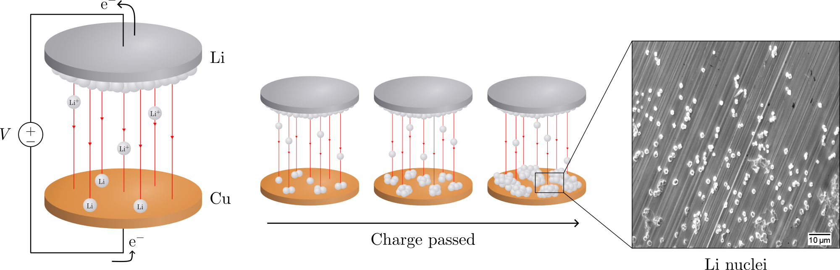
Electrochemical deposition of lithium on copper
Gottfrid Olsson
2024‒05–29
Notes:
Hello and welcome!
My name is Gottfrid Olsson and this master’s thesis is about electrochemical deposition of lithium on copper.

Slide 2
PLAN: 25 minute presentation
// J och V_hold I text vid figurer
//deponerat Li på SEM-bilderna

Slide 3
Batteries!
//Opening: How many here have either a smartphone, a laptop, or a smartwatch?
Cool, then you are already fans of batteries, and you likely own at least one lithium-ion battery – a very common battery type
Say, would you like your device to be smaller, lighter, and have a longer battery life? Of course you would!
It’s easy, look: replace this graphite with Li and the cell increases its energy per weight and doubles the energy per volume – very nice!
A) Let’s use this battery. Oh… what’s happening? Without the graphite, Li gets deposited on the surface. The Li grows unevenly, and oh no – look – it reached the other side of the cell! It’s a short-circuit, and [thermal runaway] *BOOM* [cell explosion] Yikes. Not good. Uneven deposition seems to be a problem.
B) However, there are several problems with such a lithium-metal battery.
//Kanske börja lite roligare som “opening:” beskriver, men sen ta (B) istället för (A).
Notes:
Batteries
Lithium-ion battery very common type; you probably have it!
Lighter and smaller by replacing graphite in LIB with Li-metal
But problems!

Slide 4
Batteries!
//figure smartphone, laptop, smartwatch?
Notes:
How many here have either a smartphone, a laptop, or a smartwatch? [raise my hand]
Cool, then you are already fans of batteries, and you likely own at least one lithium-ion battery – a very common battery type …

Slide 5
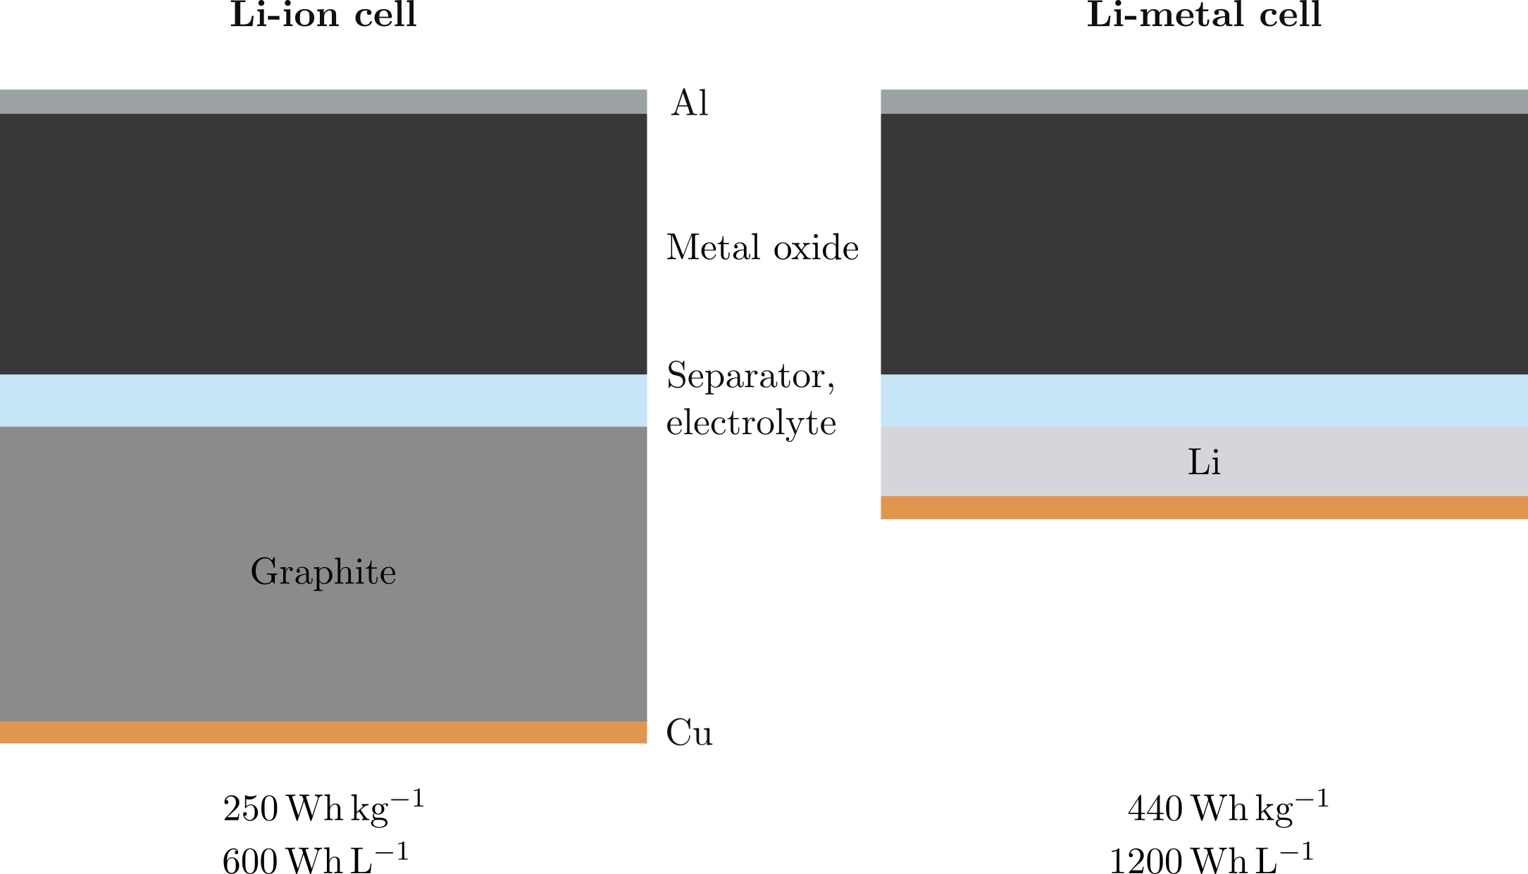
Batteries!
Notes:
It looks like this. [short pause]
Say, would you like your smartphone, laptop, or smartwatch to be smaller or lighter? Of course you would!
Well it’s easy, let’s replace the graphite with Li, …

Slide 6
Batteries!
Notes:
And violá!
We have a lithium-metal battery.
This change can …

Slide 7
Batteries!
Notes:
increase the specific energy and double the energy density of the cell.
This would not only make your laptop easier to carry, but would benefit for example electrical vehicles where the size and weight of today’s batteries are an obstacle.
Sounds too good to be true, right? =D
Yeah there are some problems, because the Li here can become uneven …
At the pack level:
* Li-ion cell: 150 Wh/kg, 250 Wh/L
Li-metal cell: 250 Wh/kg, 750 Wh/L
(http://large.stanford.edu/courses/2020/ph240/kim1/)

Slide 8
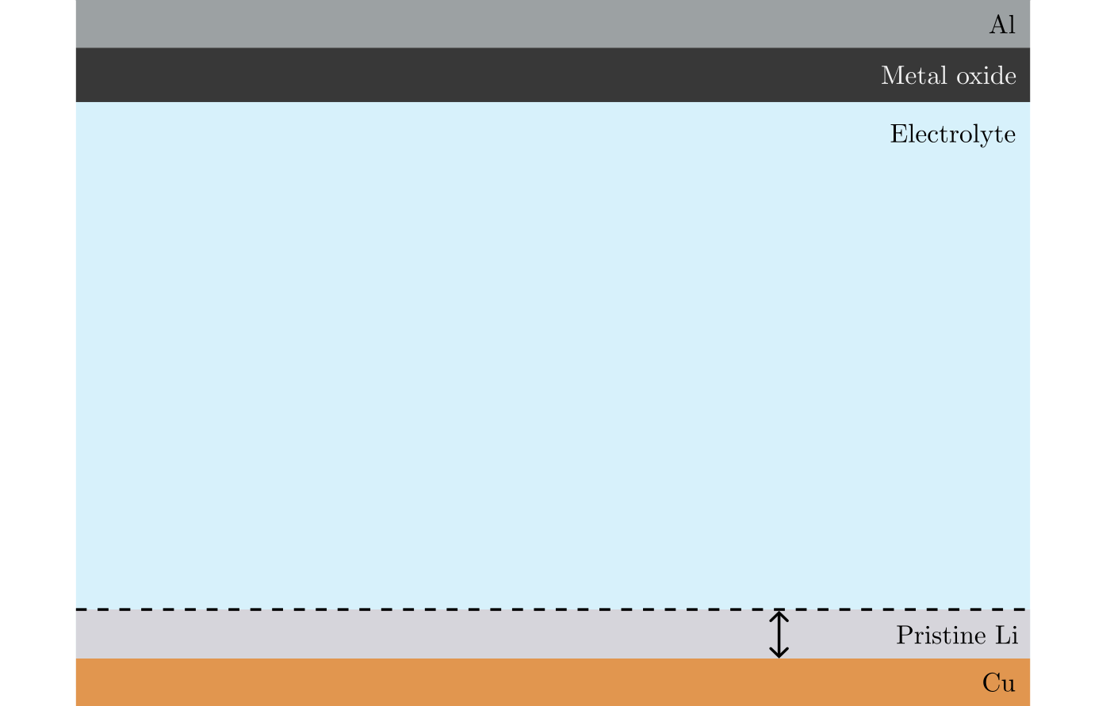
Non-uniform deposition problems
Notes:
Say we have a new cell which we charge and discharge: this means Li moves back and forth [point].

Slide 9
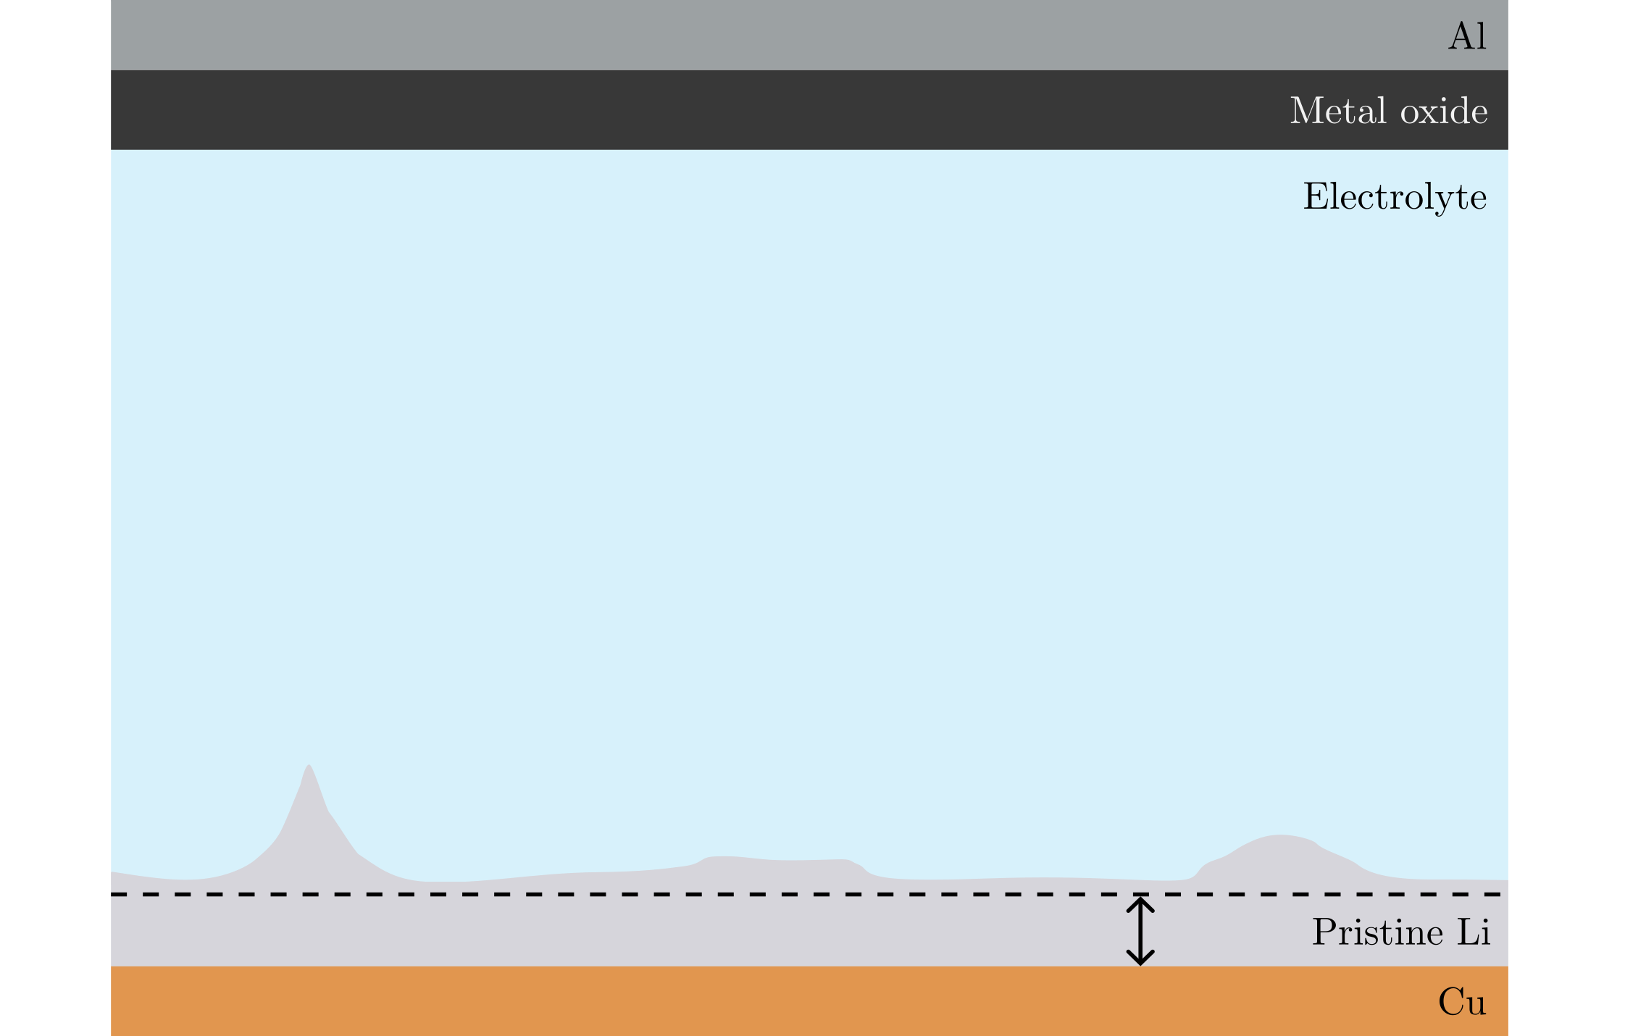
Non-uniform deposition problems
Notes:
Li can get deposited on the surface more in some places than others…

Slide 10
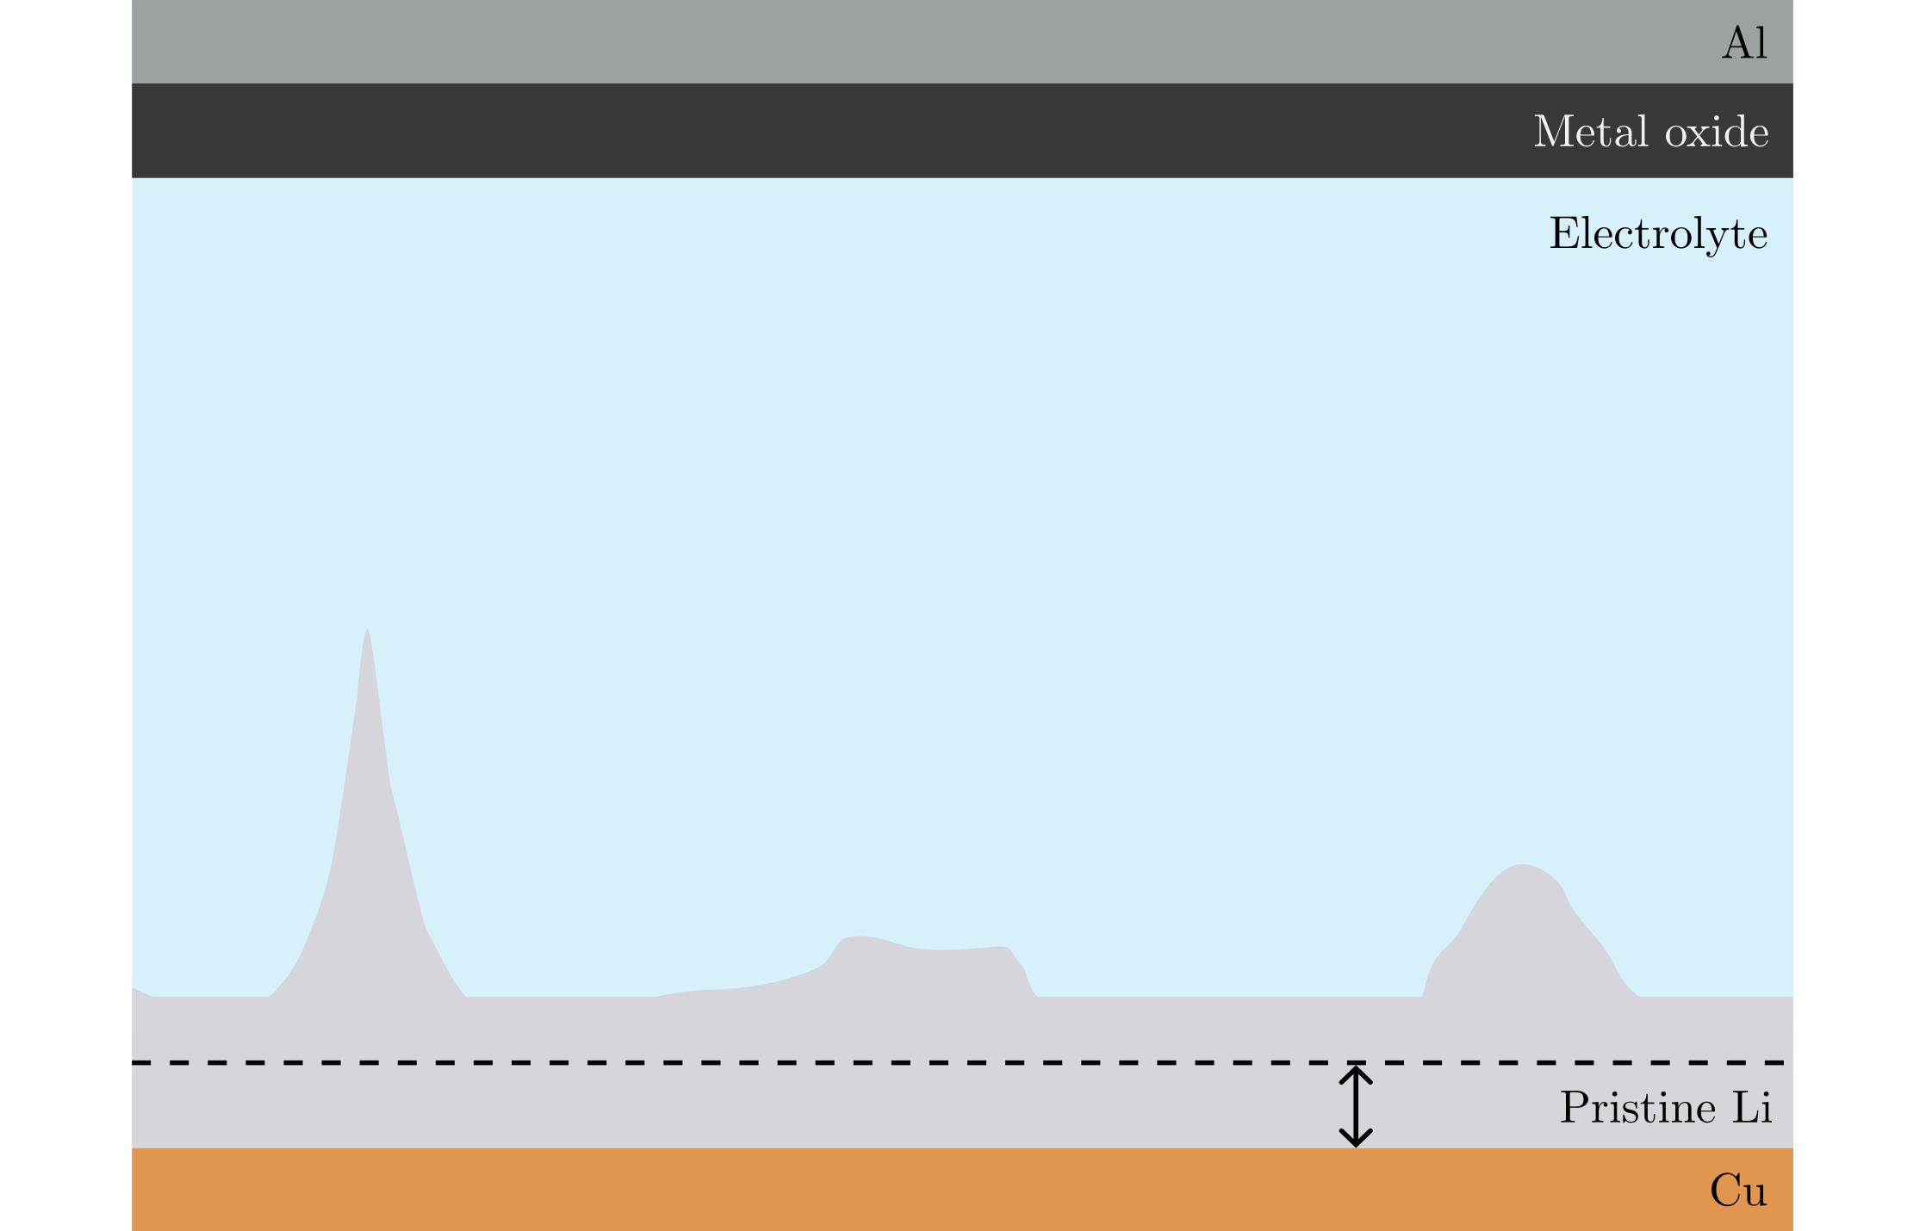
Non-uniform deposition problems
Notes:
Those places can then grow further…

Slide 11
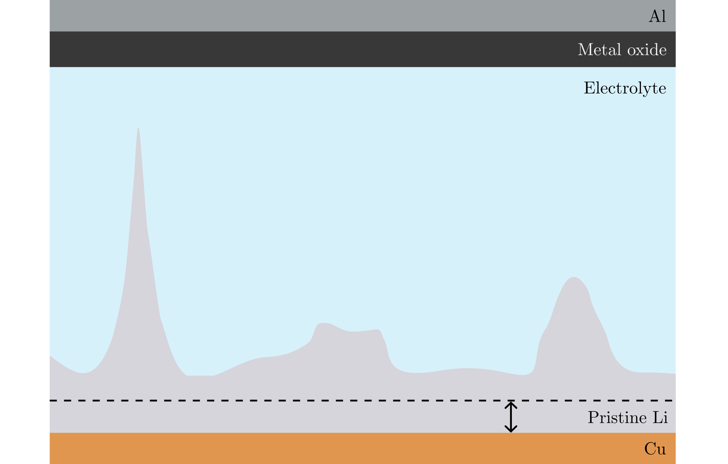
Non-uniform deposition problems
Notes:
And even more until, in the worst case…

Slide 12
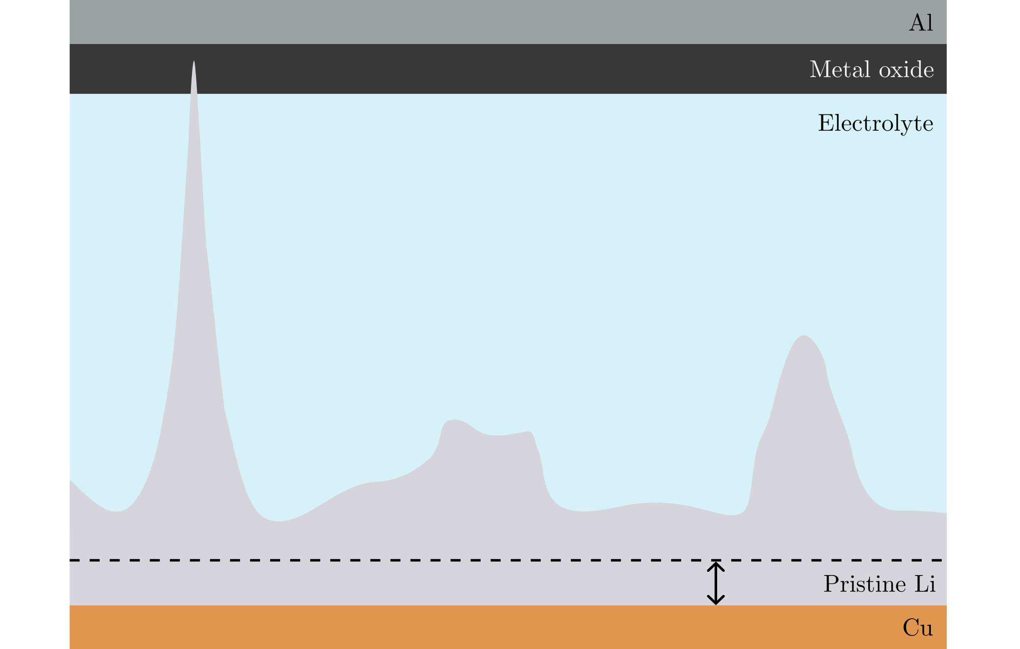
Non-uniform deposition problems
Notes:
It reaches the other side and short circuits the cell. This can lead to an explosion, and is a safety risk.

Slide 13
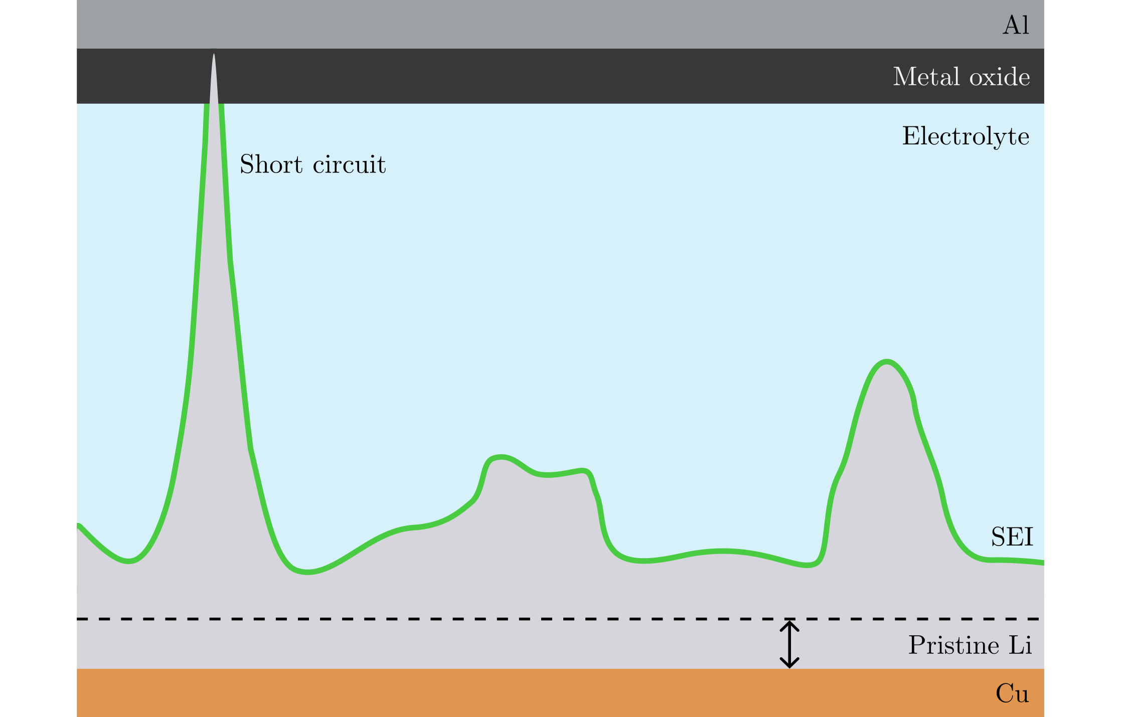
Non-uniform deposition problems
Notes:
Short circuit is one of the problems caused by non-uniform deposition.
This green stuff is called the solid electrolyte interphase – SEI.
For low voltage, the electrolyte is broken down and reacts with Li to form this SEI layer.
It is generally good because it stops other reactions, but …

Slide 14
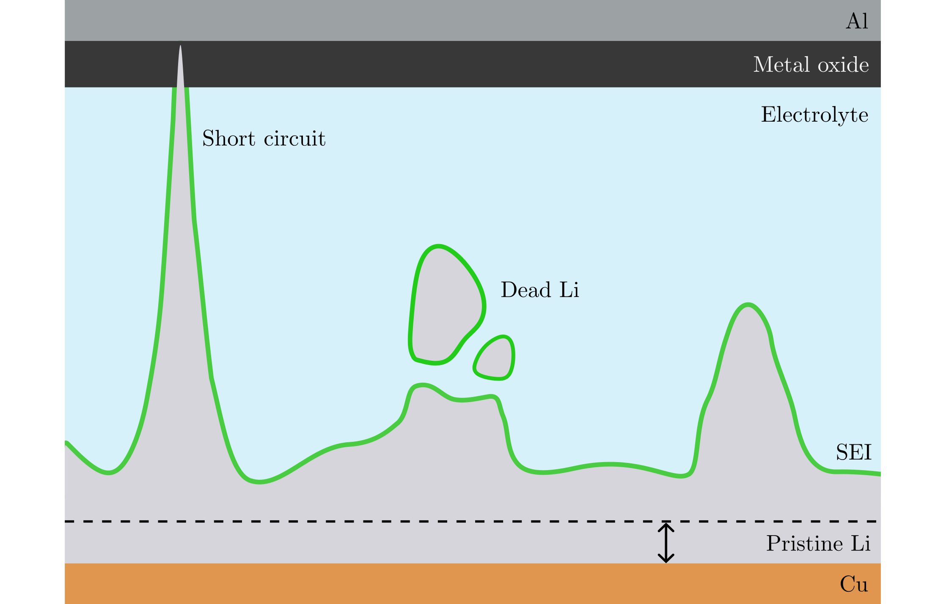
Non-uniform deposition problems
Notes:
if the SEI covers pieces of Li, it becomes electronically isolated and ‘’dead’’ as it can no longer contribute to the battery charge.
This lowers the life time of the battery.

Slide 15
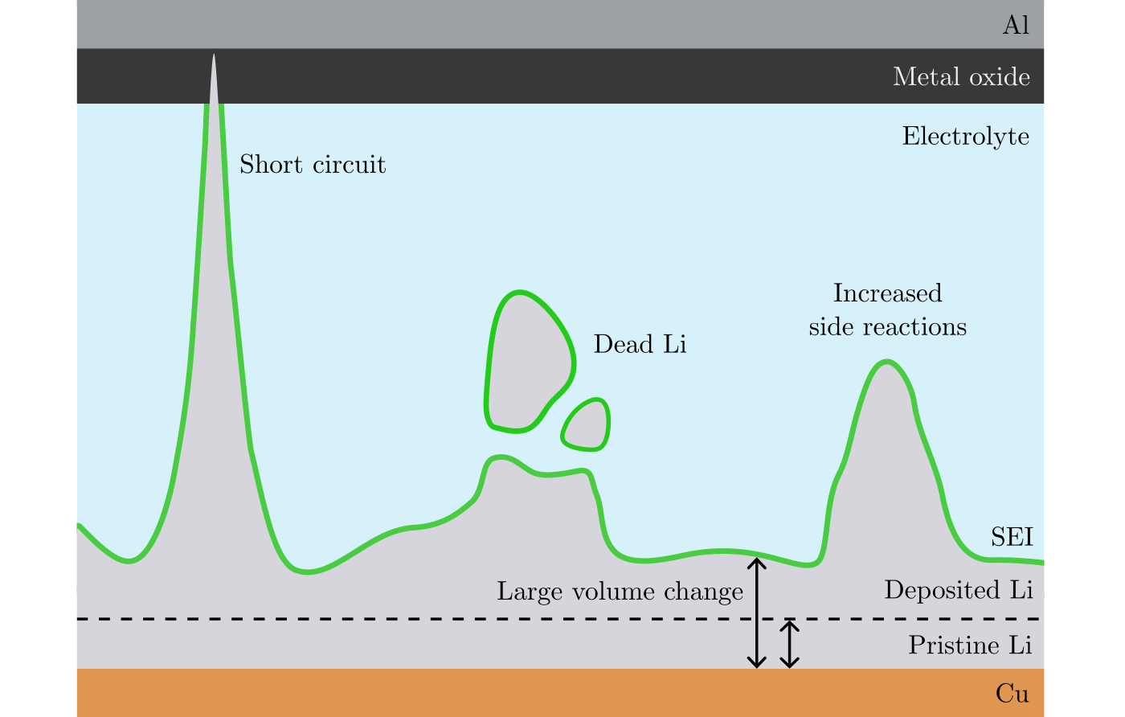
Non-uniform deposition problems
Notes:
Also, the difference in volume between the deposited and the pristine Li induces mechanical stress, which can crack the SEI which then reforms, consuming more Li.
In short, non-uniform deposition is a safety risk [short circuit], and lowers the performance of the battery [dead and volume change].

Slide 16
Purpose of this thesis
Investigate the nucleation – the first step in deposition.
Electrochemical measurements and scanning electron microscopy.
Notes:
To avoid non-uniform deposition, the first step in deposition of Li – nucleation, must be well understood.
By understanding nucleation better, ways of inducing more uniform deposition can be found.
I have used electrochemical measurements and scanning electron microscopy (SEM) to image the Li.

Slide 17
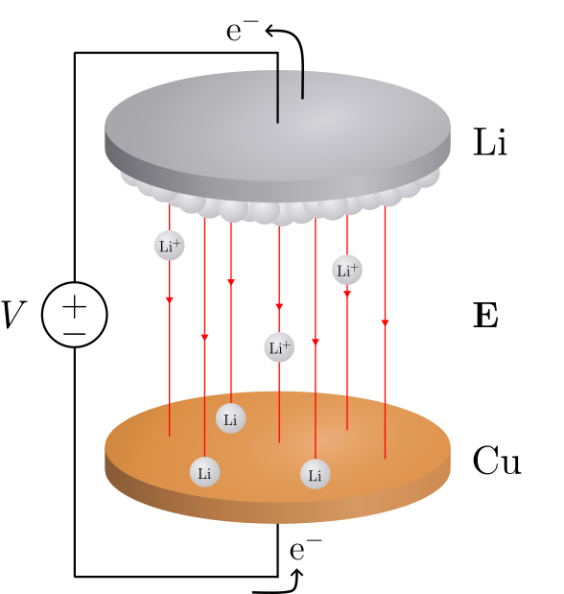
Deposition in a Li/Cu cell
Notes:
How does deposition work?
Here is a schematic of a Li/Cu cell.
Voltage difference → electrical fields → force on positive charges, Li-ions.
Li atoms can release their electrons here [point].
The electron moves along the circuit while the Li-ions moves toward the Cu.
Li-ions can recombine with electrons to form Li on the Cu surface.

Slide 18
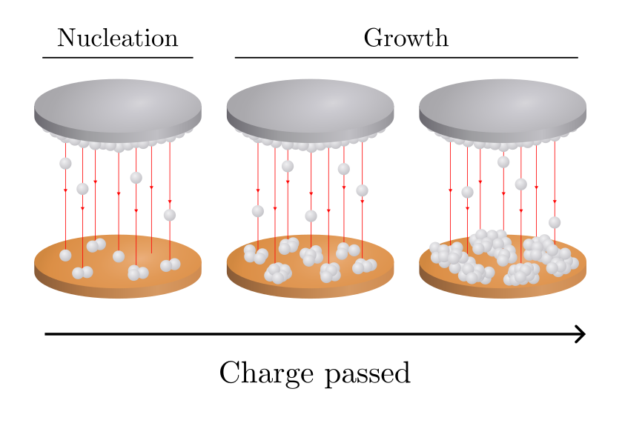
Deposition in a Li/Cu cell
Notes:
As more charge is passed (measured by the current, the electrons), more and more Li is deposited.

Slide 19
Deposition in a Li/Cu cell
Notes:
We identify two stages: nucleation and growth.
Nucleation is the first part and is the focus of this thesis.

Slide 20
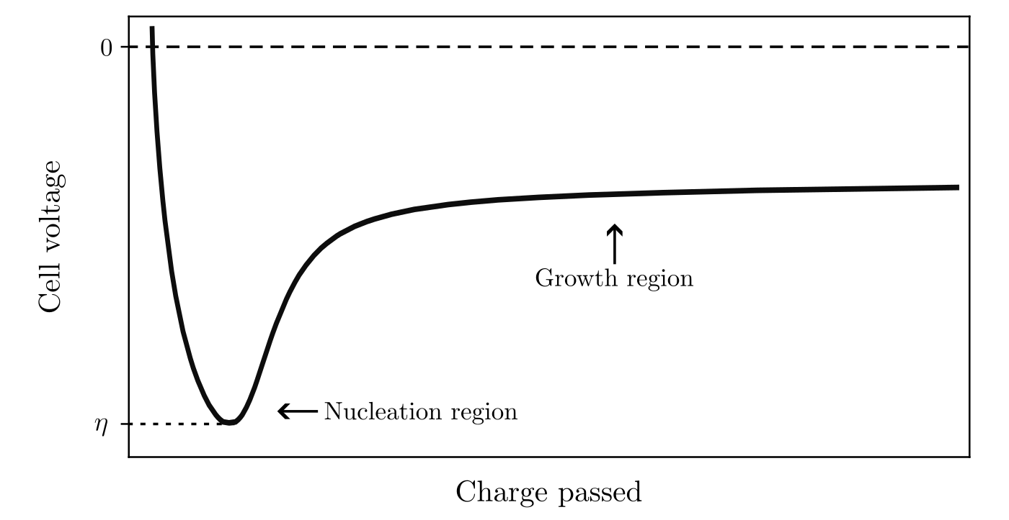
Deposition in a Li/Cu cell
Notes:
Let’s look at how the cell voltage varies with charge passed during deposition.

Slide 21
Deposition in a Li/Cu cell
Notes:
There is first a sharp drop in potential, reaching a lowest value of eta – this we will call the overpotential of nucleation.
At this point of the curve, nucleation occurs.

Slide 22
Deposition in a Li/Cu cell
Notes:
Then, the voltage goes up and the nuclei grow.

Slide 23
Deposition in a Li/Cu cell
Notes:
And they continue to grow as more charge get passed.
So, the focus is on the nucleation [point].
What is nucleation?

Slide 24
Nucleation
Notes:
Nucleation is the first step in forming a new phase within a substance.

Slide 25
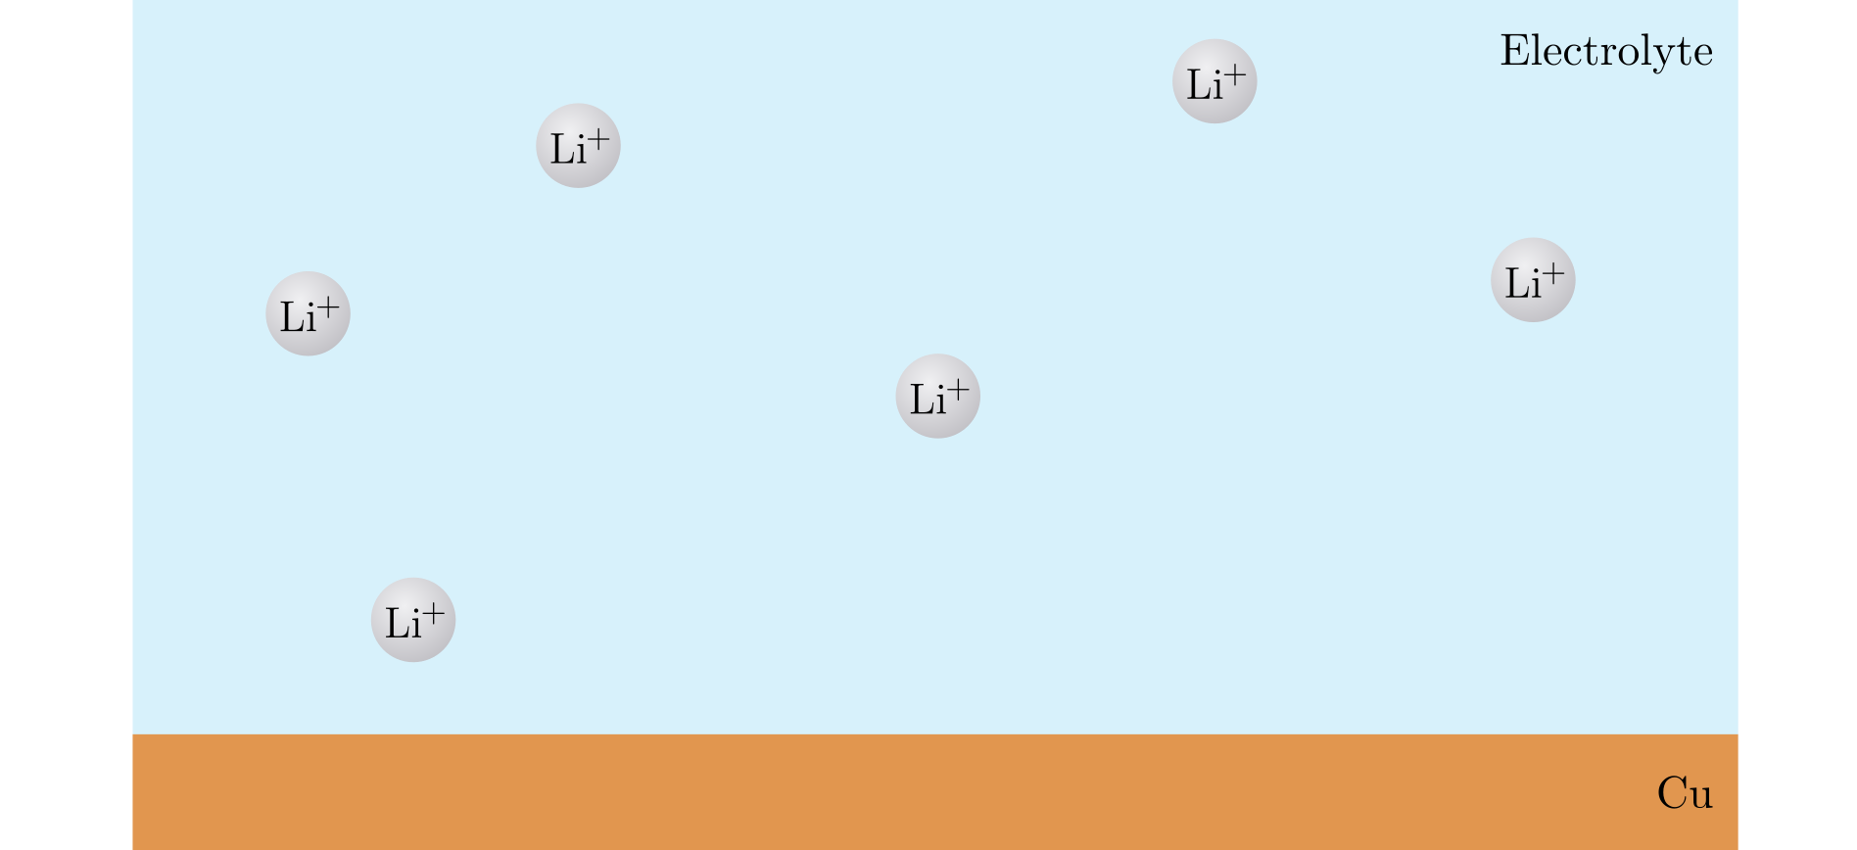
Nucleation
Notes:
In our case, imagine Li-ions in a solution – a liquid.

Slide 26
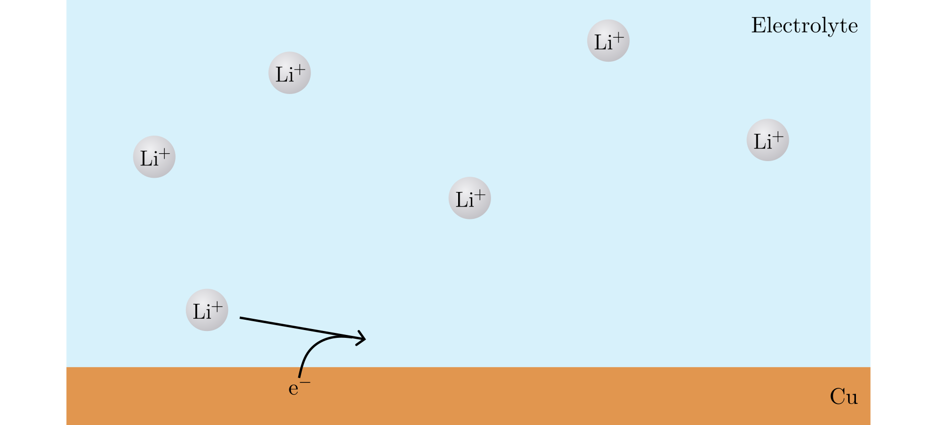
Nucleation
Notes:
A Li+ ion can take up an electron and …

Slide 27
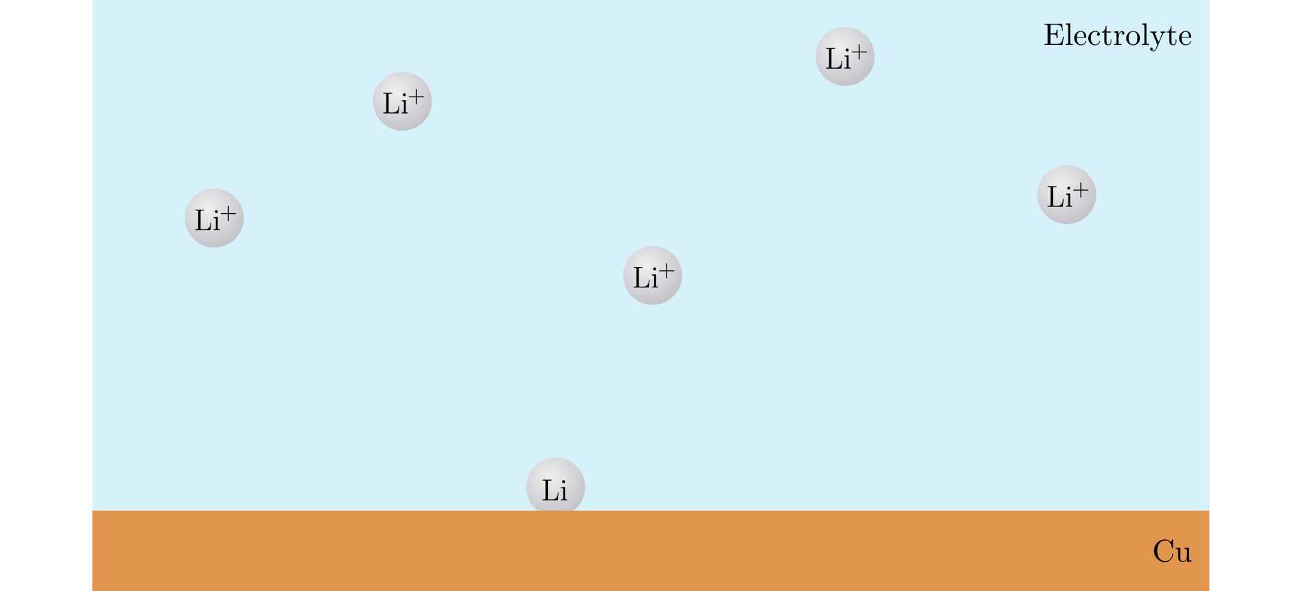
Nucleation
Notes:
Become a Li atom on the Cu surface.

Slide 28
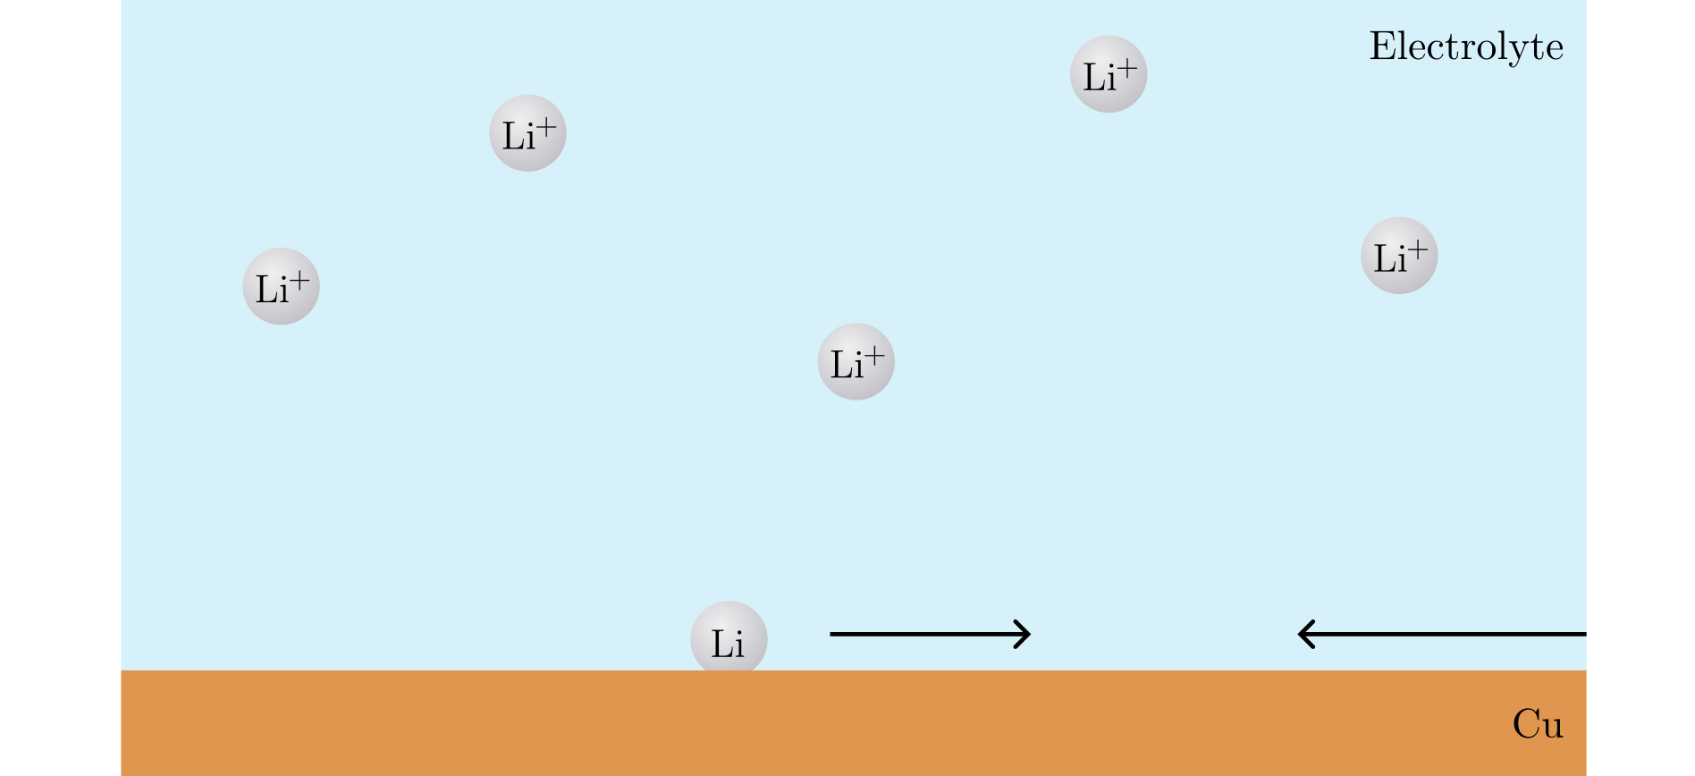
Nucleation
Notes:
If several Li atoms come together …

Slide 29
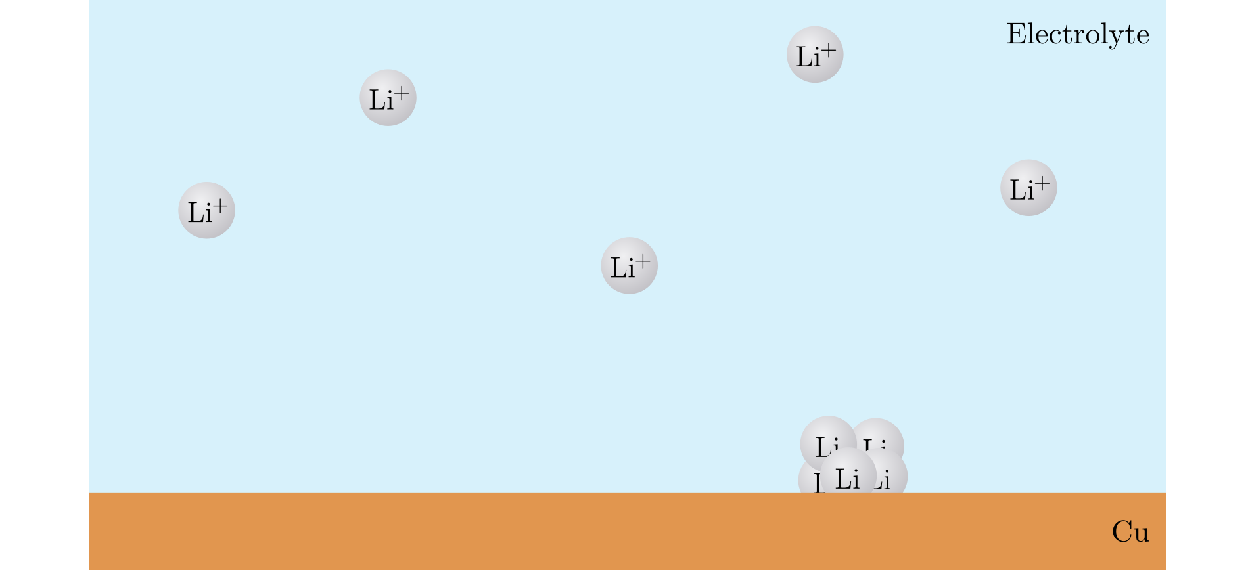
Nucleation
Notes:
A small cluster is formed.

Slide 30
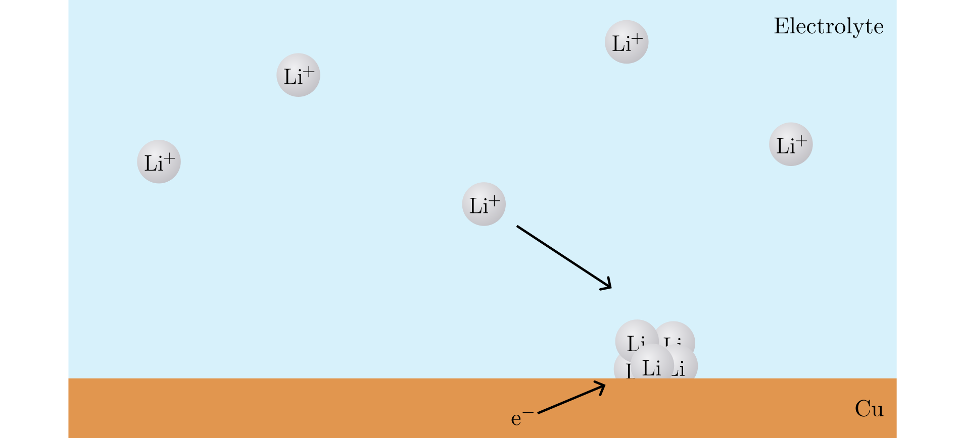
Nucleation
Notes:
As more Li gets added to the cluster…

Slide 31
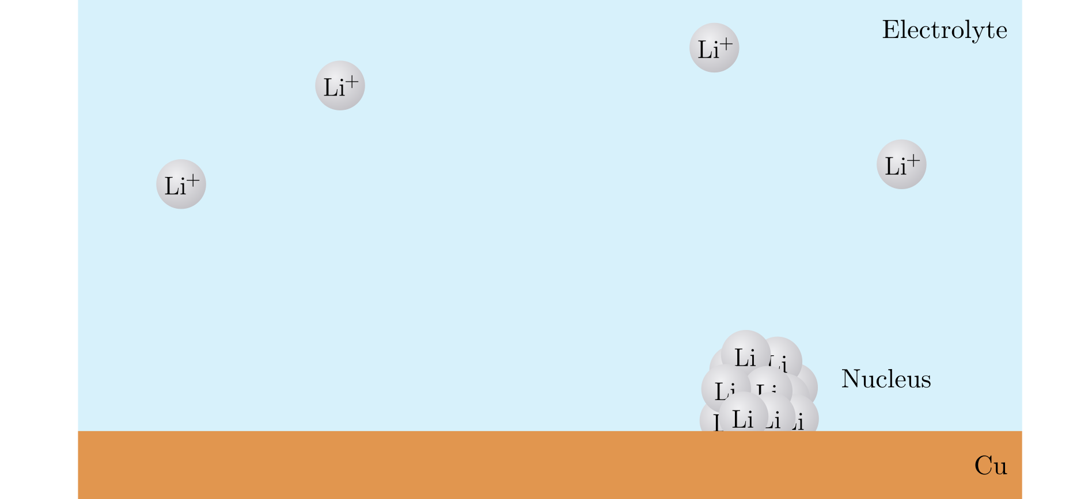
Nucleation
Notes:
A nucleus is formed.
This formation of the new SOLID phase from the LIQUID, is called nucleation.
It is useful to model this with nucleation theory.

Slide 32
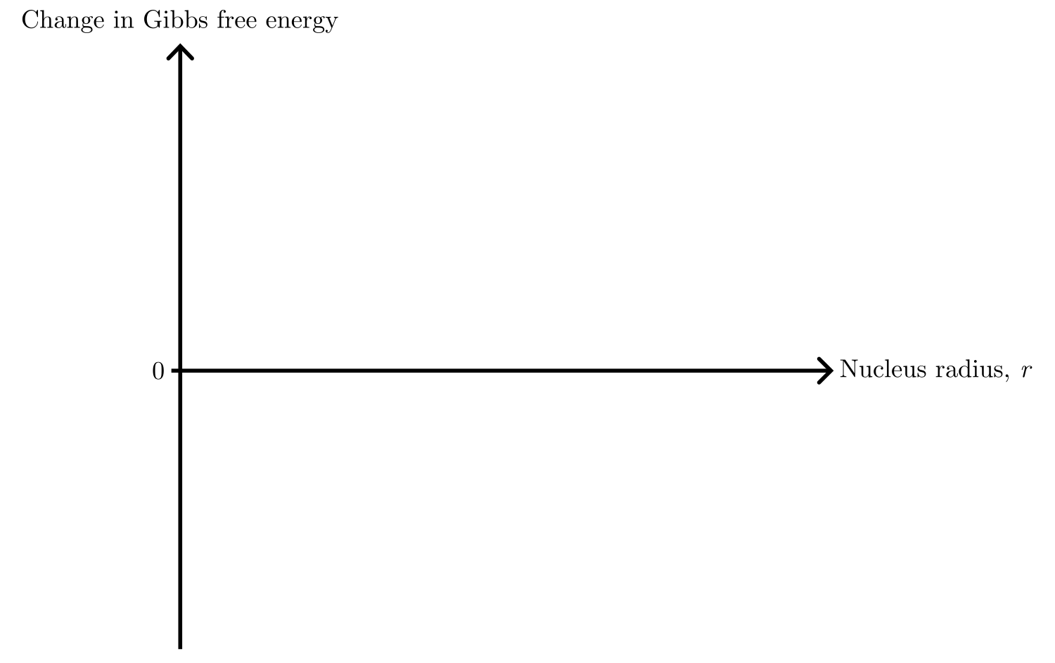
Nucleation theory
Notes:
Nucleation is modelled by looking at the change in Gibbs free energy of the system as function of radius (assuming a spherical nucleus).

Slide 33
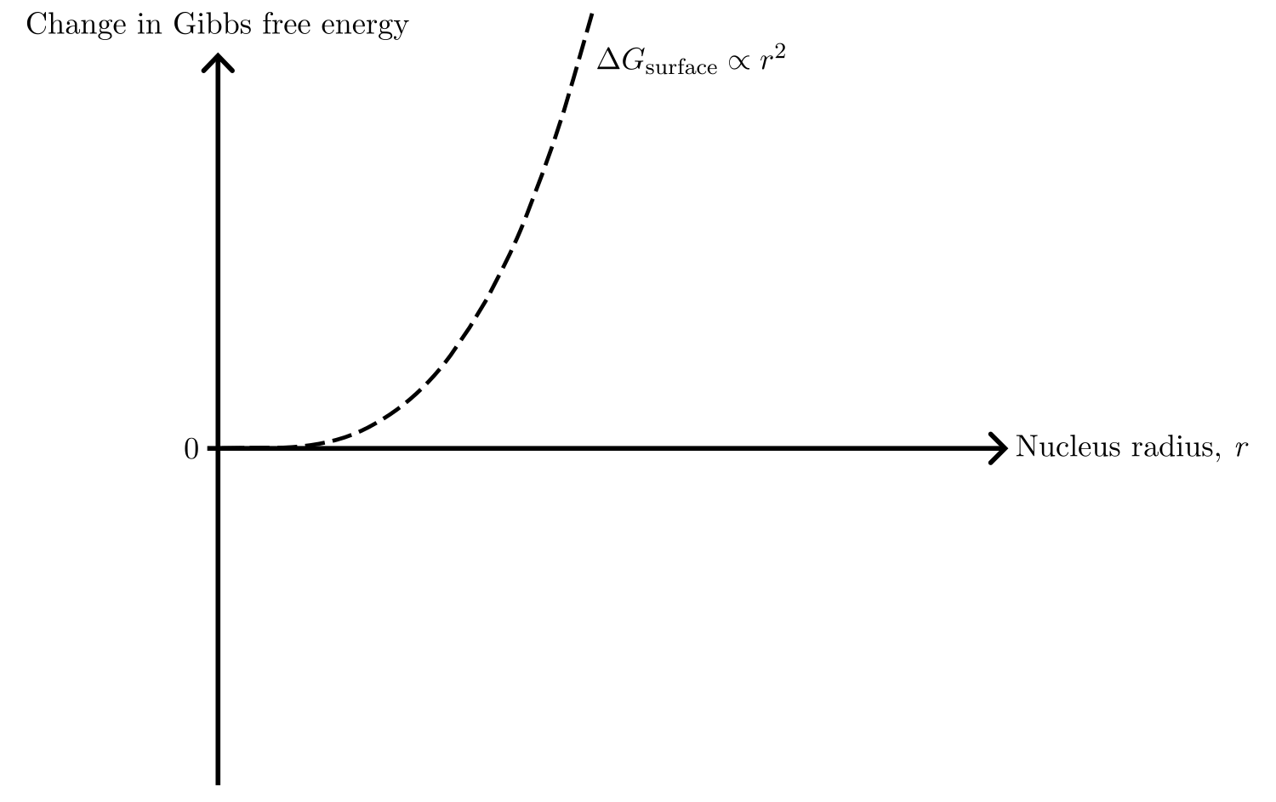
Nucleation theory
Notes:
To form the new phase, there is a cost for creating surface area.
It grows as r².

Slide 34
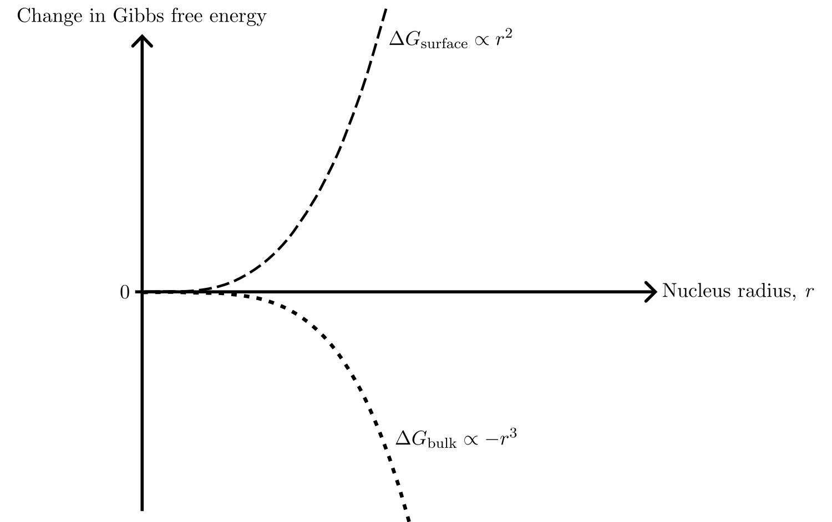
Nucleation theory
Notes:
At the same time, there is a gain in energy from creating bulk. Scaling as –r³.
The sum of these …

Slide 35
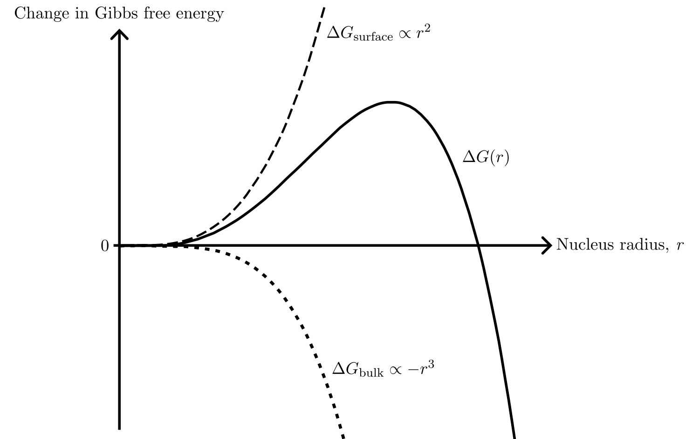
Nucleation theory
Notes:
DeltaG, is the change in Gibs free energy for creating a nucleus of a certain size r.
It costs energy to build a nucleus, up until this point…

Slide 36
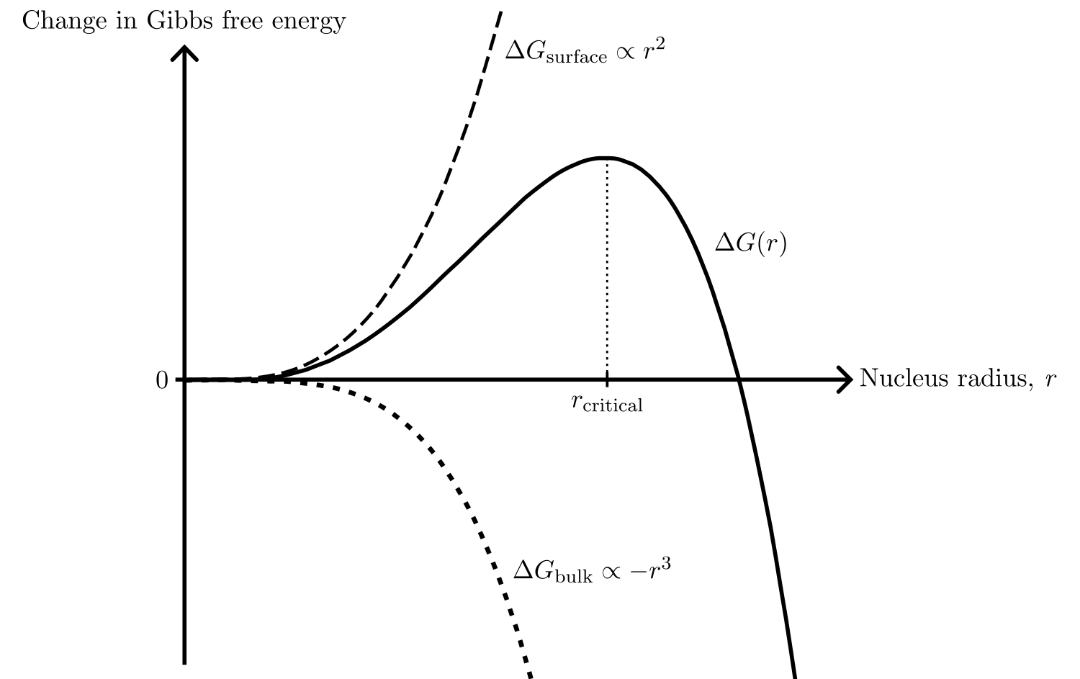
Nucleation theory
Notes:
This is the critical radius, where the nucleus start to grow spontaneously as this lowers the overall energy of the system.
Because for large r the bulk-term dominates.
But to get to that point, there is an energy barrier …

Slide 37
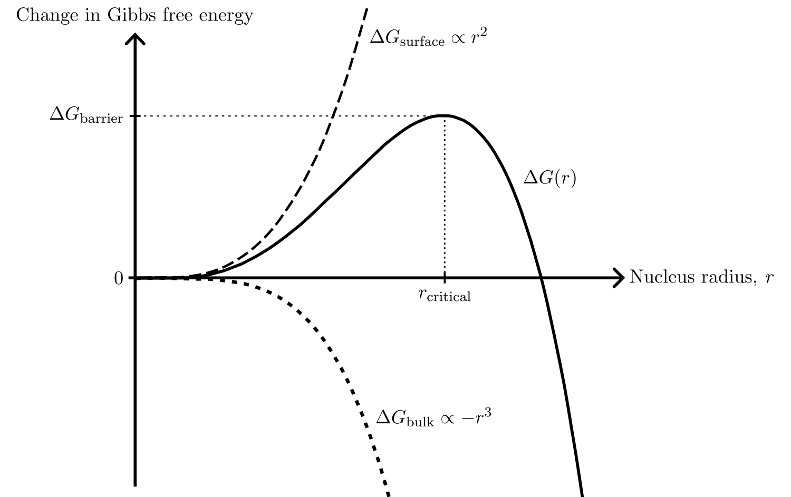
Nucleation theory
Notes:
Delta G_barrier, which needs to be overcome.

Slide 38
Nucleation theory
Notes:
We saw the effect of this barrier in the deposition curve, with the sharp drop in the voltage.
We need to put in energy for the Li to nucleate, and more for nucleation than growth, as is seen from the graph here [point].

Slide 39
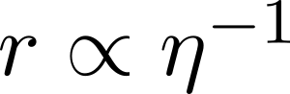
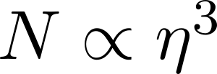
Nucleation theory
Notes:
From nucleation theory, one can show that the size of the nucleus r is inversely proportional to the overpotential eta, and that the number of nuclei per area N is proportional to the third power of the overpotential.

Slide 40
Nucleation theory
Notes:
What does this means?

Slide 41
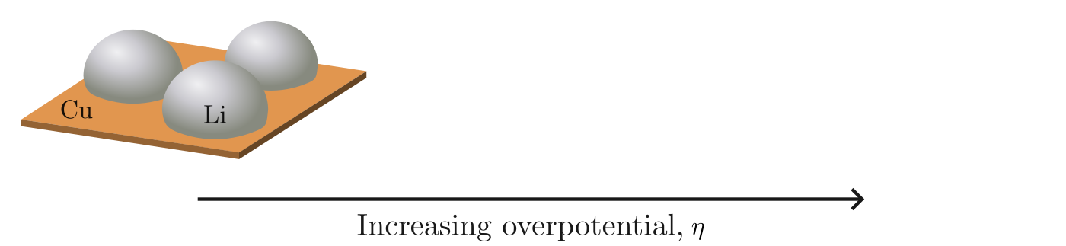
Nucleation theory
Notes:
For low overpotential: large and few nuclei.

Slide 42
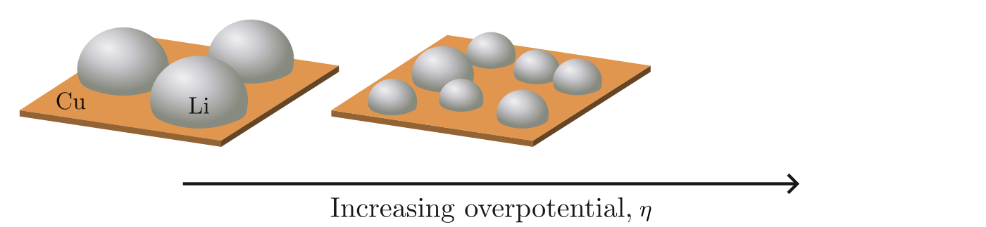
Nucleation theory
Notes:
For increasing overpotential…

Slide 43
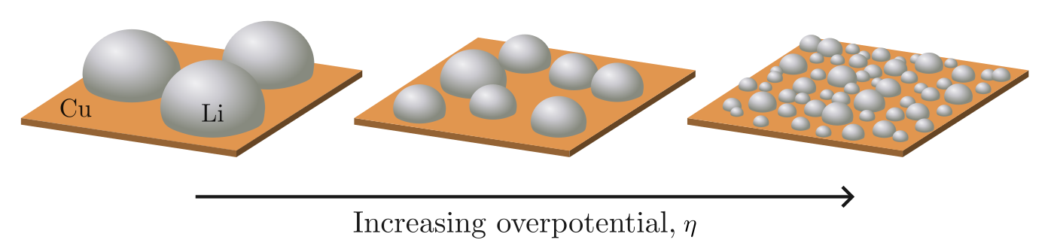
Nucleation theory
Notes:
smaller nuclei but more per area.
Thus, the overpotential influences the size and number of nuclei.

Slide 44
Scientific questions in this thesis
The shape of the deposition curve
Degree of passivation of the Cu surface
Deposition current
Distribution of the nuclei
Pressure distribution between the Li and Cu
Notes:
Now, this thesis will specifically focus on how the shape of the deposition curve, and how the distribution of the nuclei can be affected.

Slide 45
Scientific questions in this thesis
The shape of the deposition curve
Degree of passivation of the Cu surface
Deposition current
Distribution of the nuclei
Pressure distribution between the Li and Cu
Notes:
The shape will be investigated by looking at the degree of passivation of the Cu surface, and the current during deposition.

Slide 46
Scientific questions in this thesis
The shape of the deposition curve
Degree of passivation of the Cu surface
Deposition current
Distribution of the nuclei
Pressure between the Li and Cu
Notes:
We will look at how the pressure between the Li and Cu affects the distribution of the nuclei.

Slide 47
Scientific questions in this thesis
The shape of the deposition curve
Degree of passivation of the Cu surface
Deposition current
Distribution of the nuclei
Pressure between the Li and Cu
← Measure V during deposition
← Image Li nuclei using SEM
Notes:
For the first one, I’ve measured the voltage during deposition.
For the second one, I’ve imaged Li nuclei using the SEM.
To have different pressures, we need different cell setups.

Slide 48
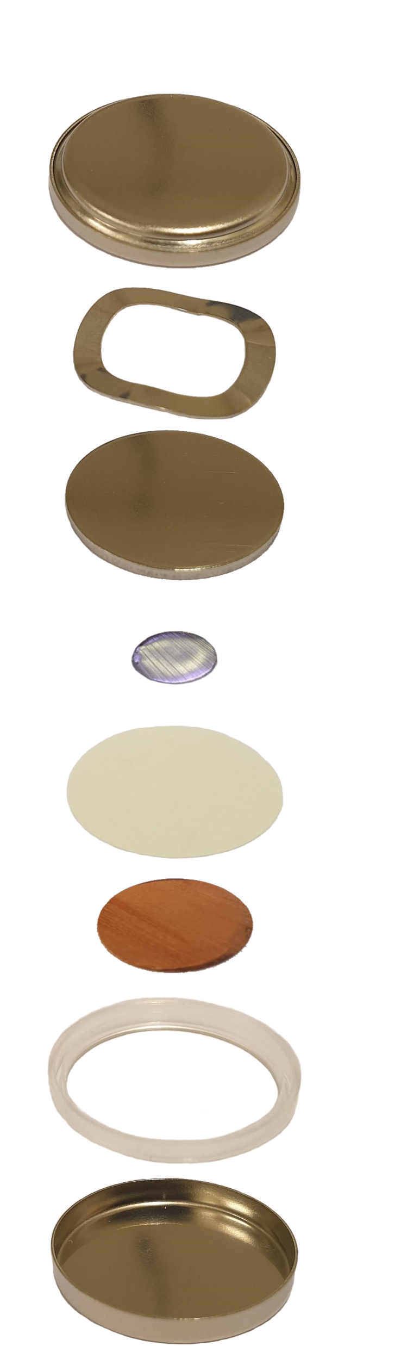
The C-cell
Cap
Spring
Spacer
Li
Separator
Cu
Gasket
Can
Notes:
First the coin cell, or C-cell.
The important parts are the Li and Cu, the separator keeping them from touching, and the spring.
Add electrolyte to the separator and push together the parts …

Slide 49
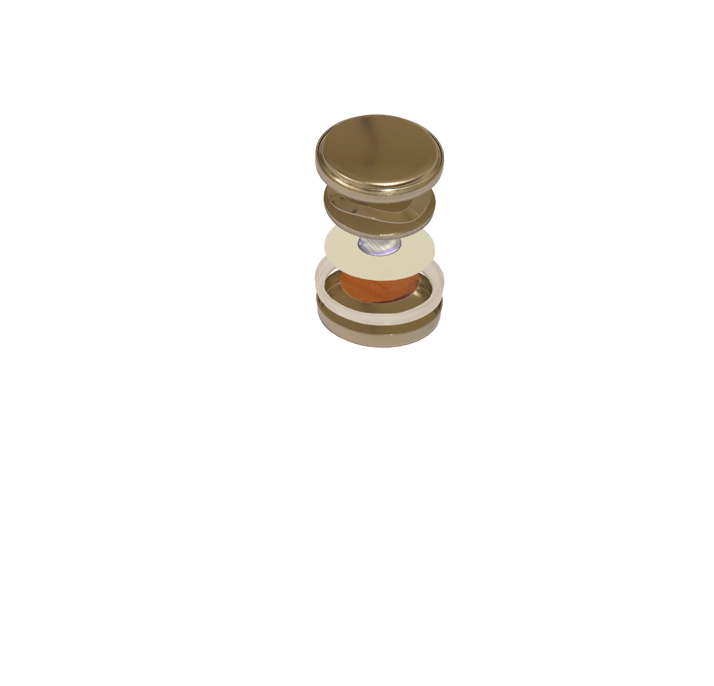
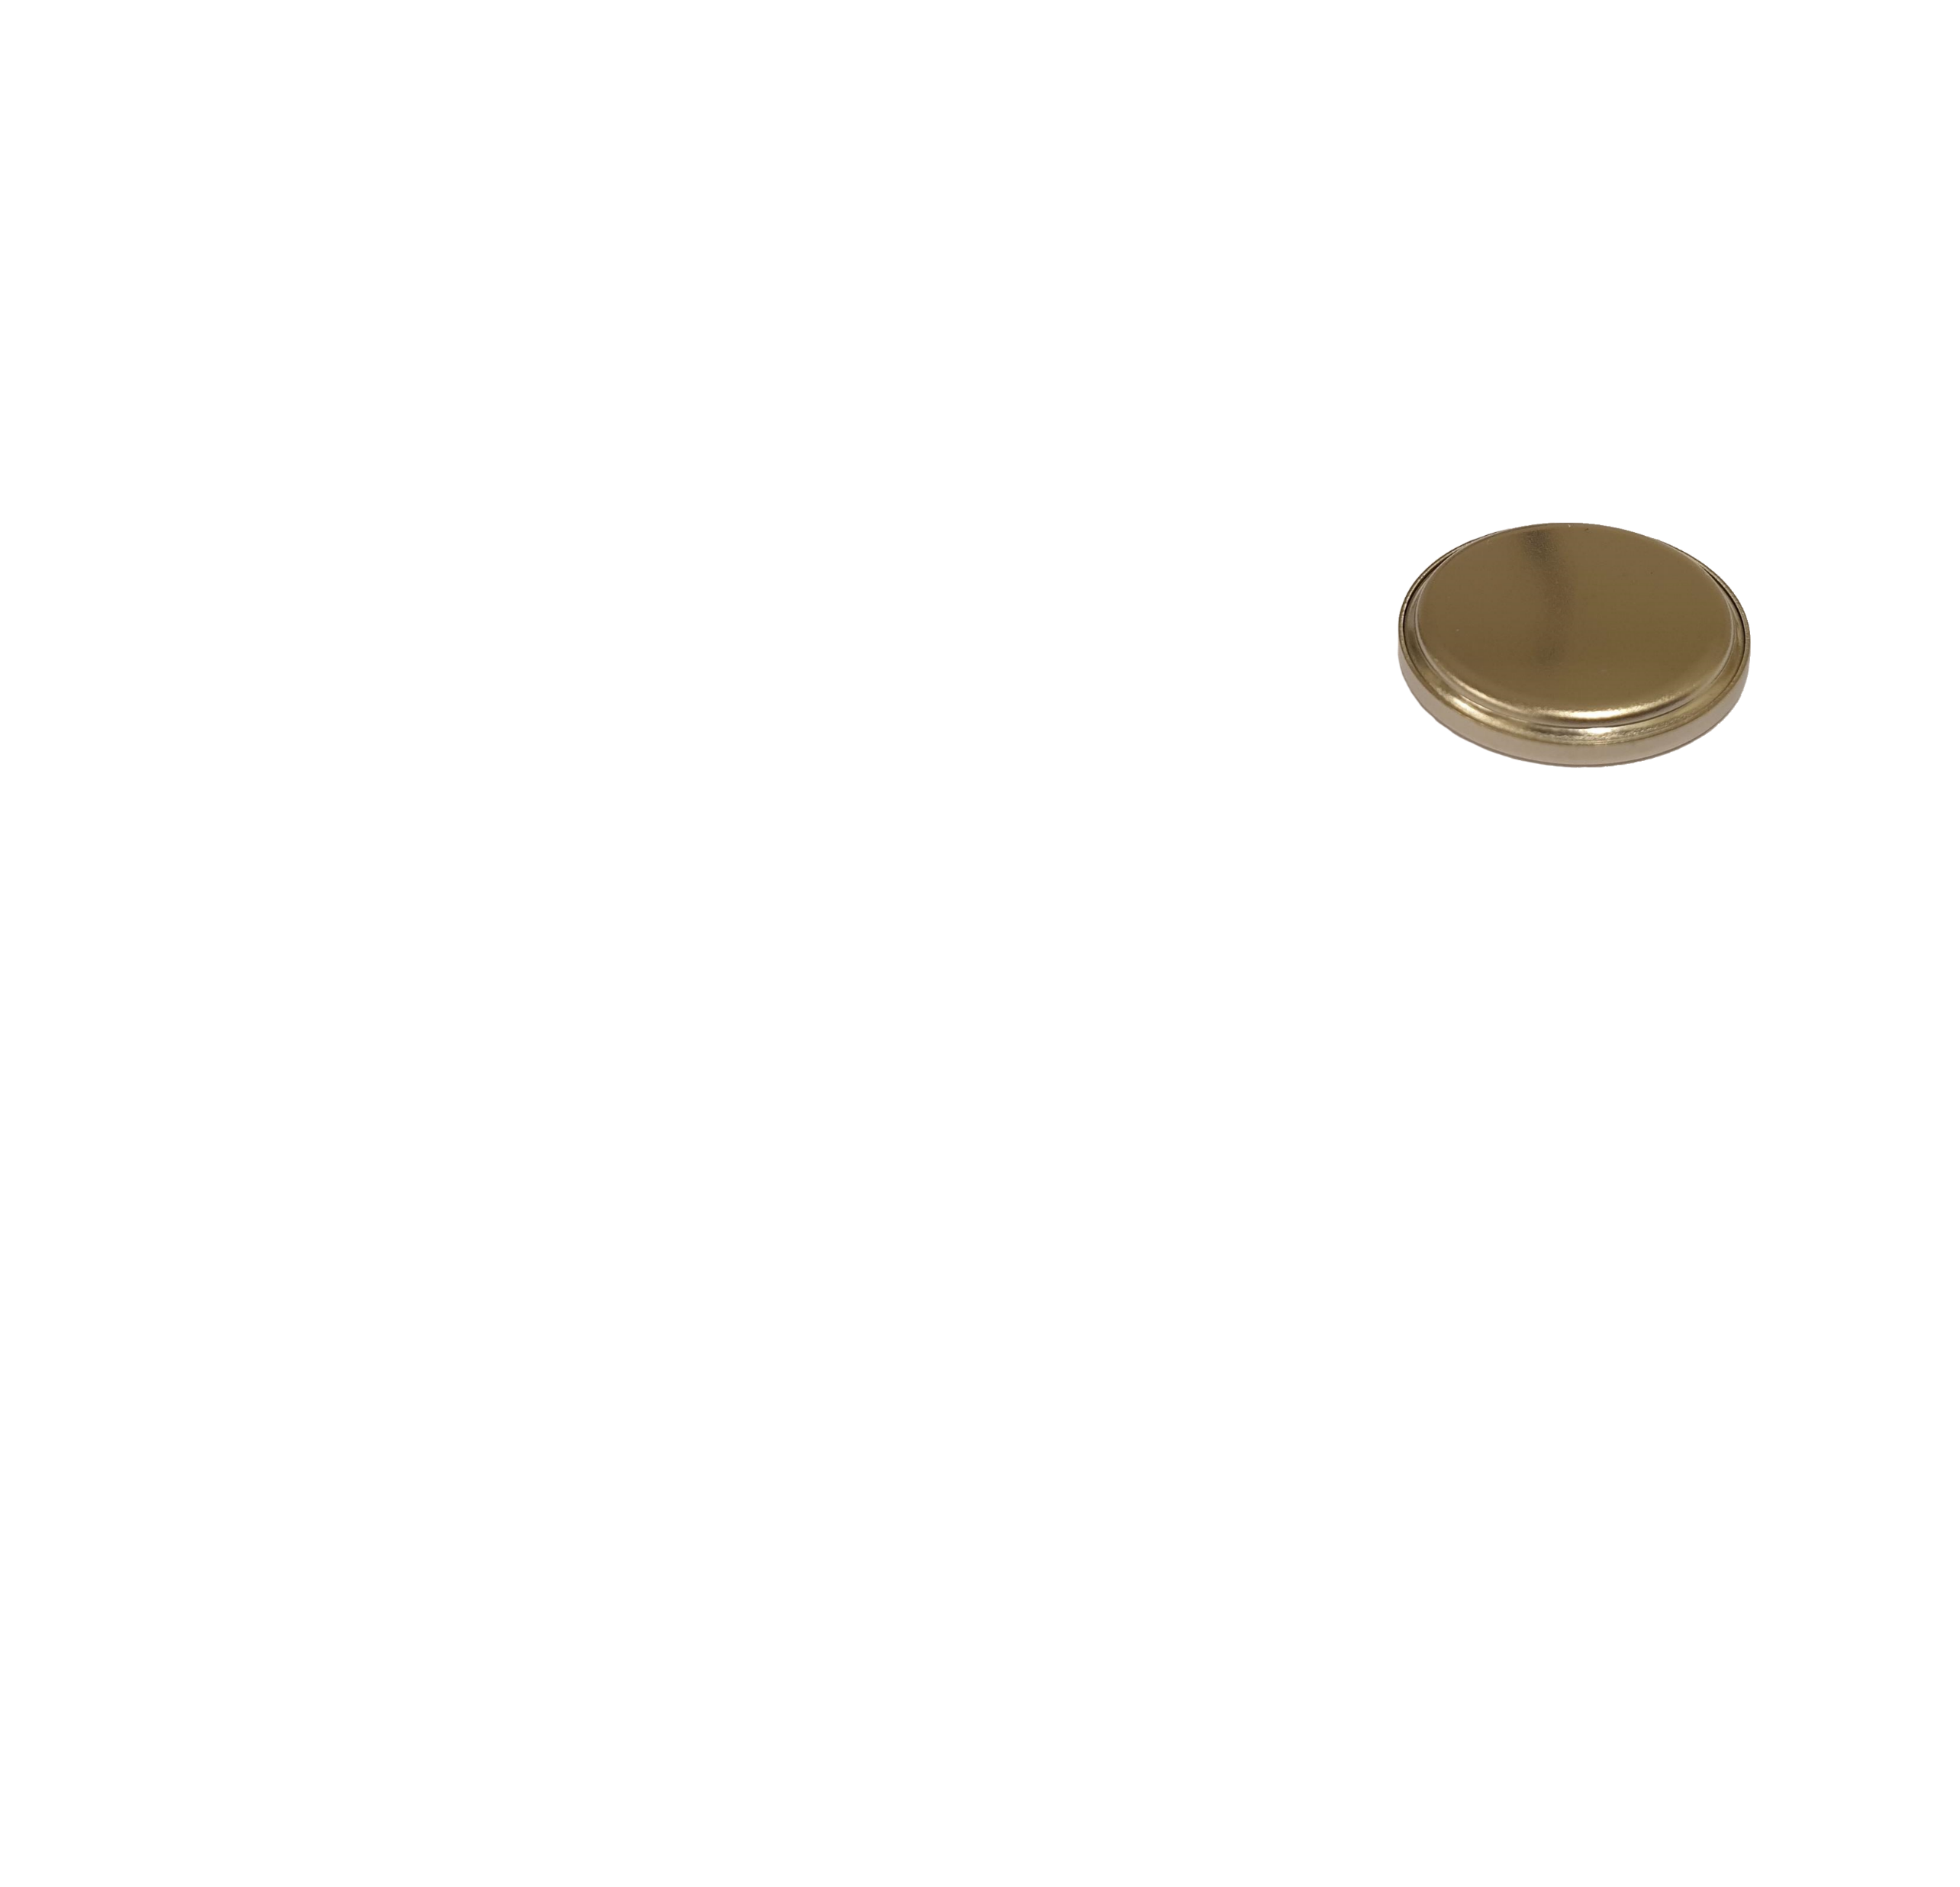
The C-cell
Cap
Spring
Spacer
Li
Separator
Cu
Gasket
Can
Notes:
Then place this in …

Slide 50
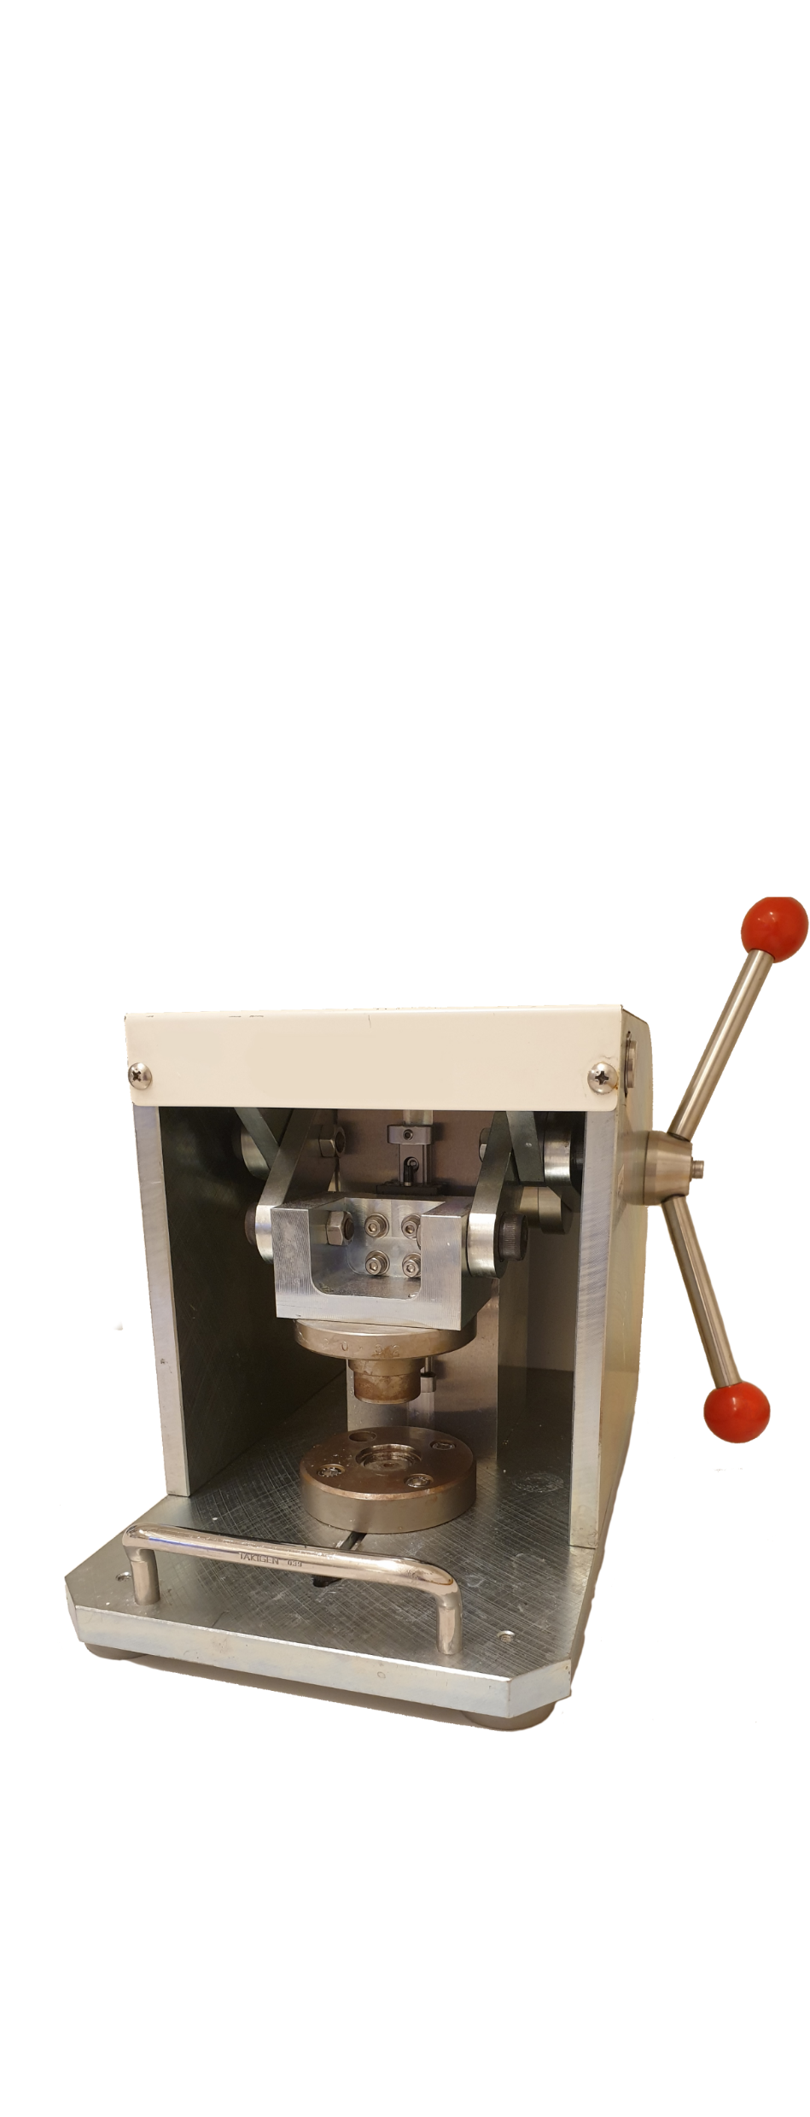
The C-cell
Cap
Spring
Spacer
Li
Separator
Cu
Gasket
Can
Notes:
Machine and turn the handles [spin finger in circle]…

Slide 51

The C-cell
Cap
Spring
Spacer
Li
Separator
Cu
Gasket
Can
Notes:
Which closes the cell by folding in the edges, and results in this.
Note that the spring now exerts a force in the cell, meaning there is pressure applied between the Li and Cu.
The other cell type is …

Slide 52
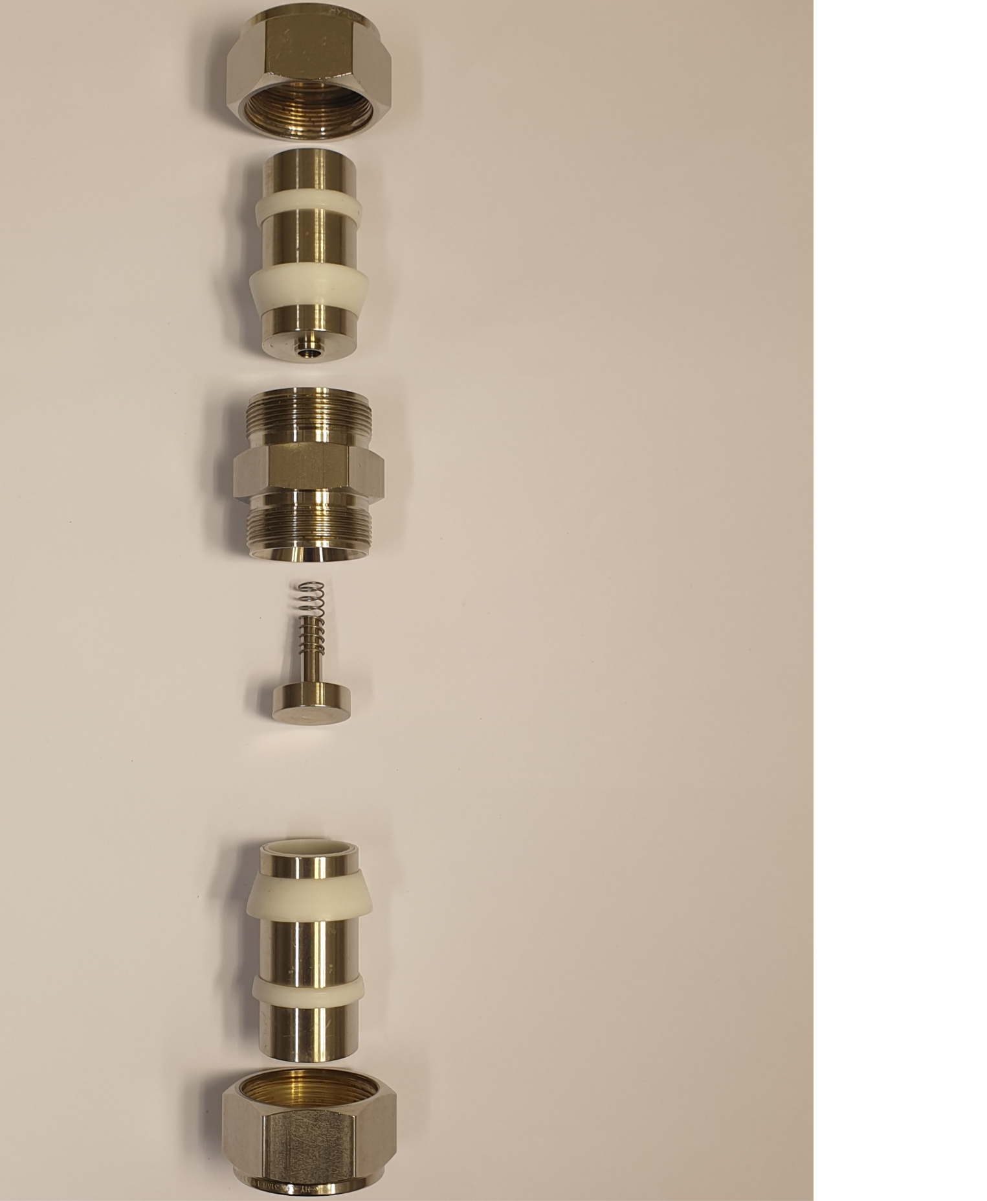
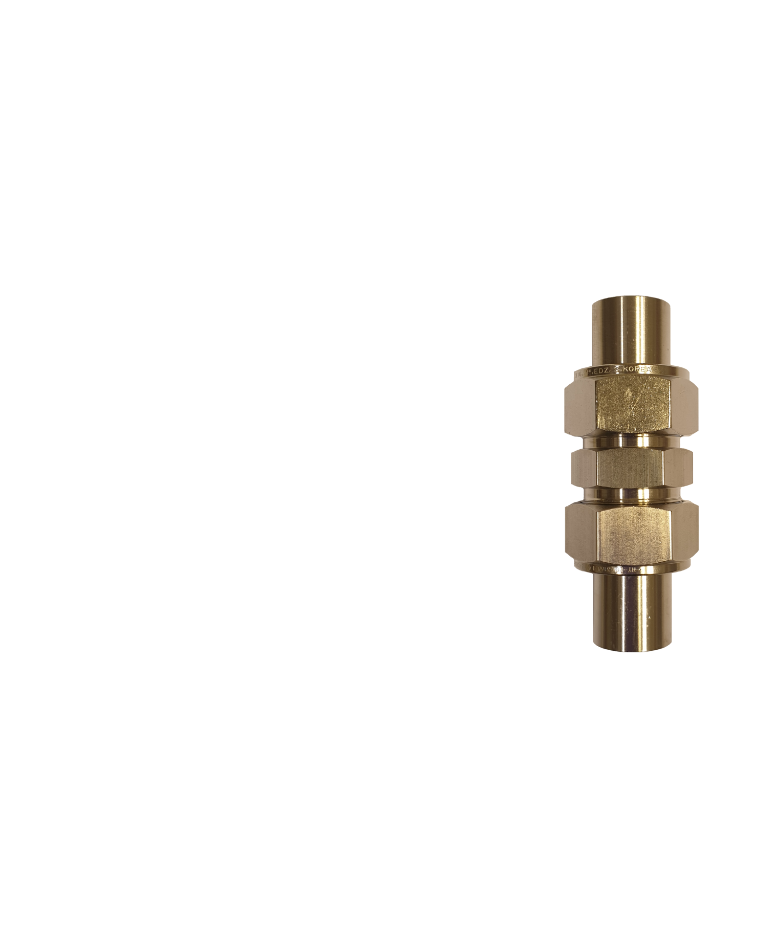

The I-cell
Nut
Metal rod
Sealing
rings
Main body
Spring
Spacer
Li
Separator
Cu

Slide 53
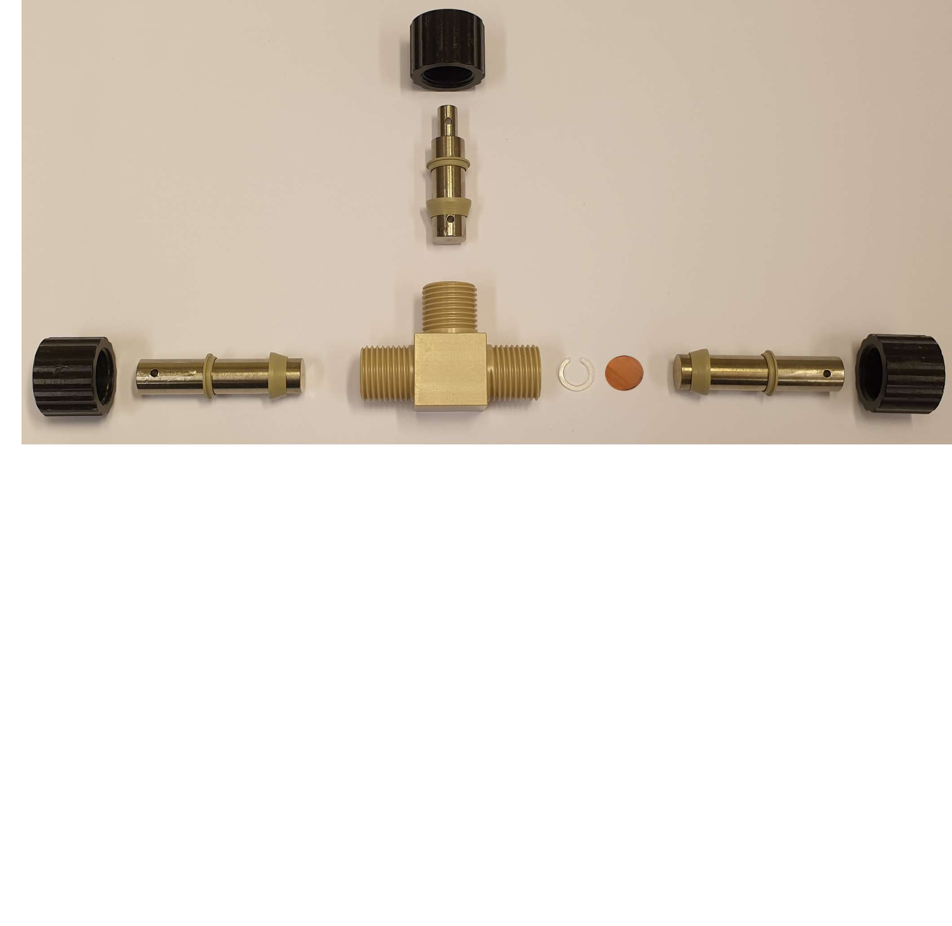

The T-cell
Nut
Metal rod
Sealing rings
Li
Main body
Spacer
Cu
Notes:
The T-cell, “T” because it has three metal rods attached to the main body in a T-shape. [pause]
Push parts together, …

Slide 54
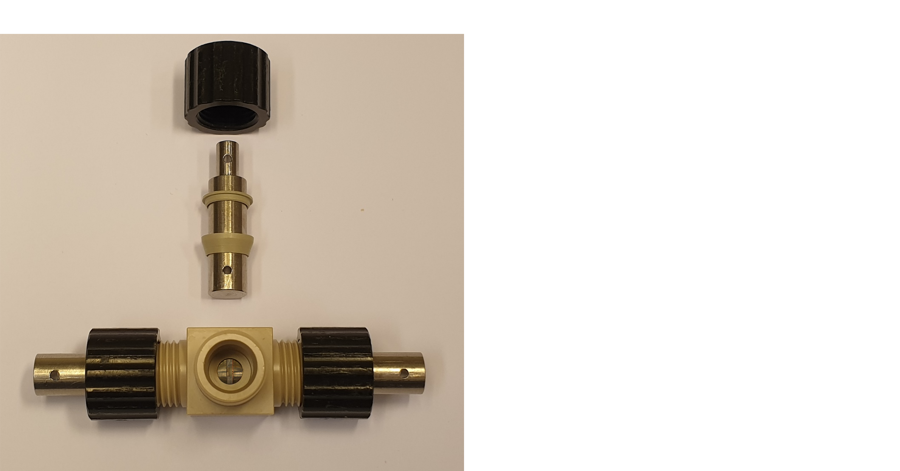
The T-cell
Notes:
And before closing the cell, electrolyte is added …

Slide 55
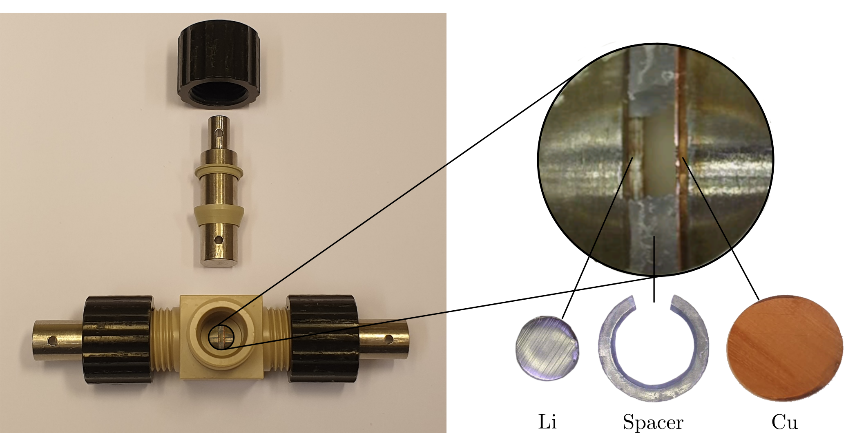
The T-cell
Notes:
Through this gap made in the spacer you can see in the zoom-in.
The spacer keeps a distance between the Li and Cu – so no applied pressure between them.

Slide 56
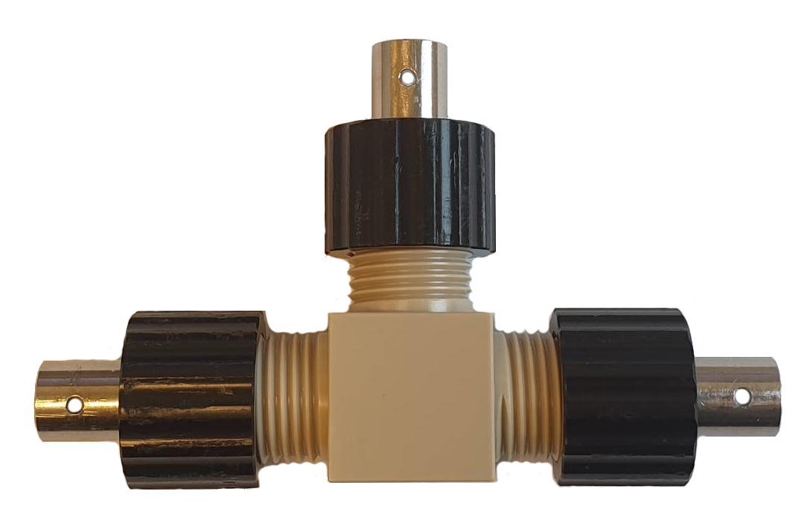
The T-cell
Notes:
The assembled cell looks like this.

Slide 57
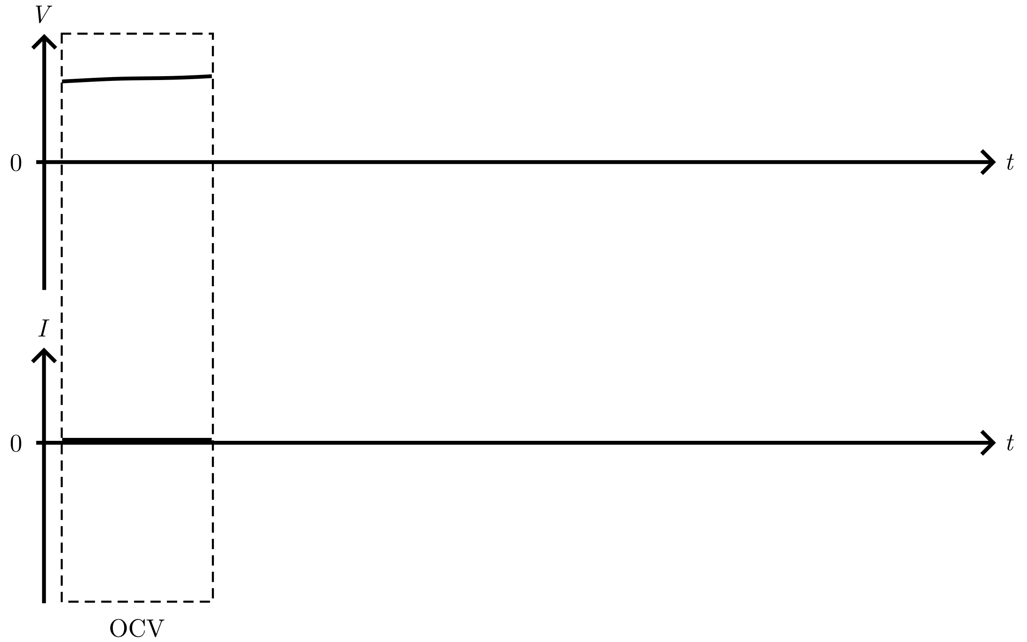
Deposition protocol
Notes:
Now we can make some cells and hook them up to a potentiostat – an instrument to control voltage or current.
To get deposition, we must cycle the cells – run a deposition protocol on them.
This protocol is shown as the voltage and current as function of time.
//(( Attach cables from the electrodes, Li and Cu, to the instrument. ))//

Slide 58
Deposition protocol
Notes:
The first part of the protocol is the OCV, open circuit voltage.
If the cell has bad voltage, something went wrong during assembly.

Slide 59
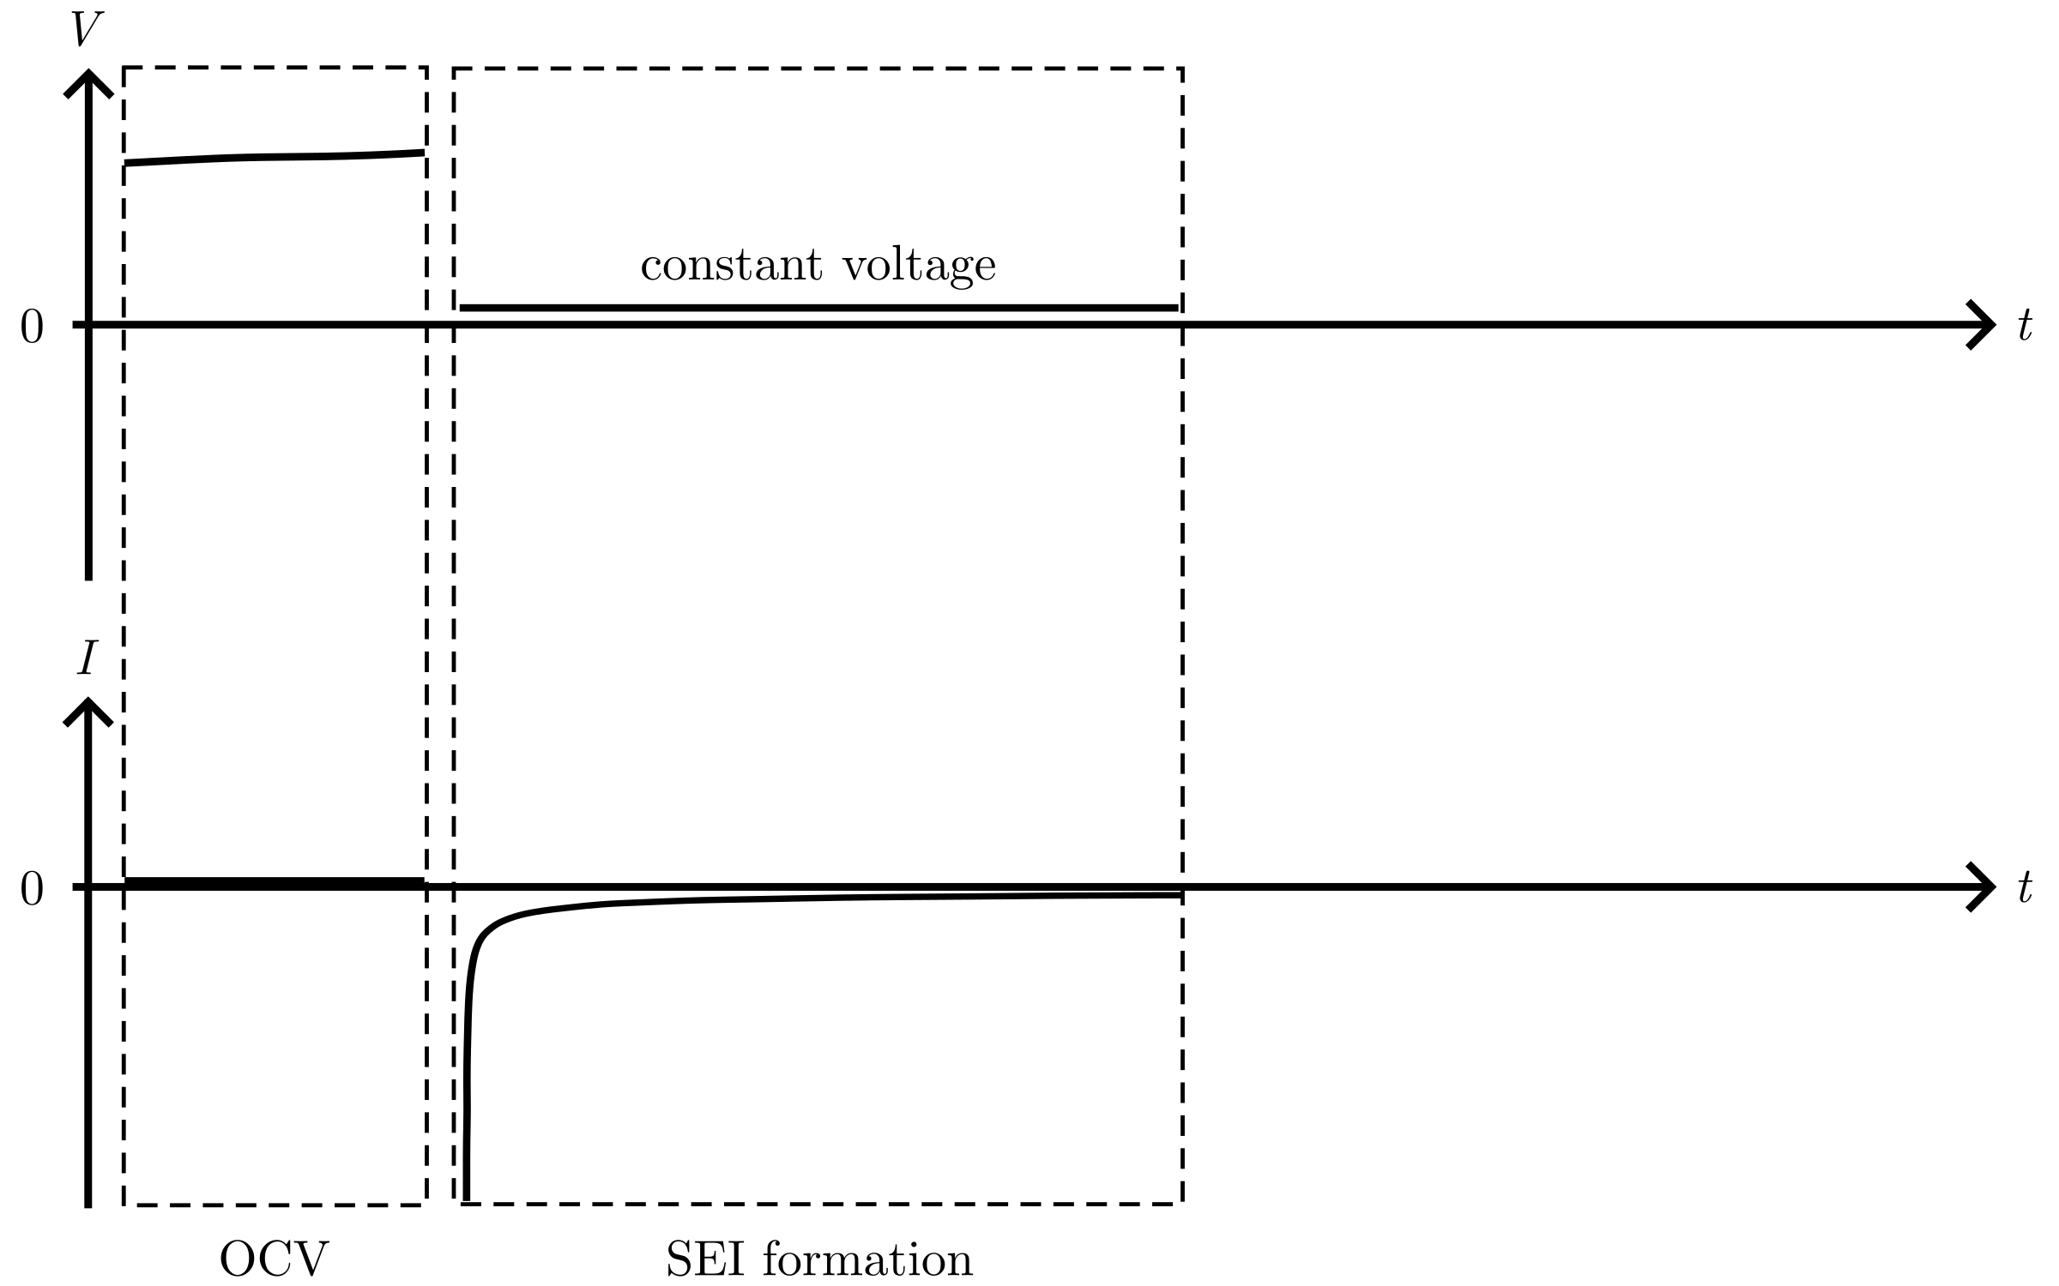
Deposition protocol
Notes:
Next is the important passivation – or SEI formation.
Here, we hold a constant and low voltage.
The electrolyte is broken down and forms the SEI layer on the Cu.
The current, which is allowed to change freely, decreases fast and then slowly.

Slide 60
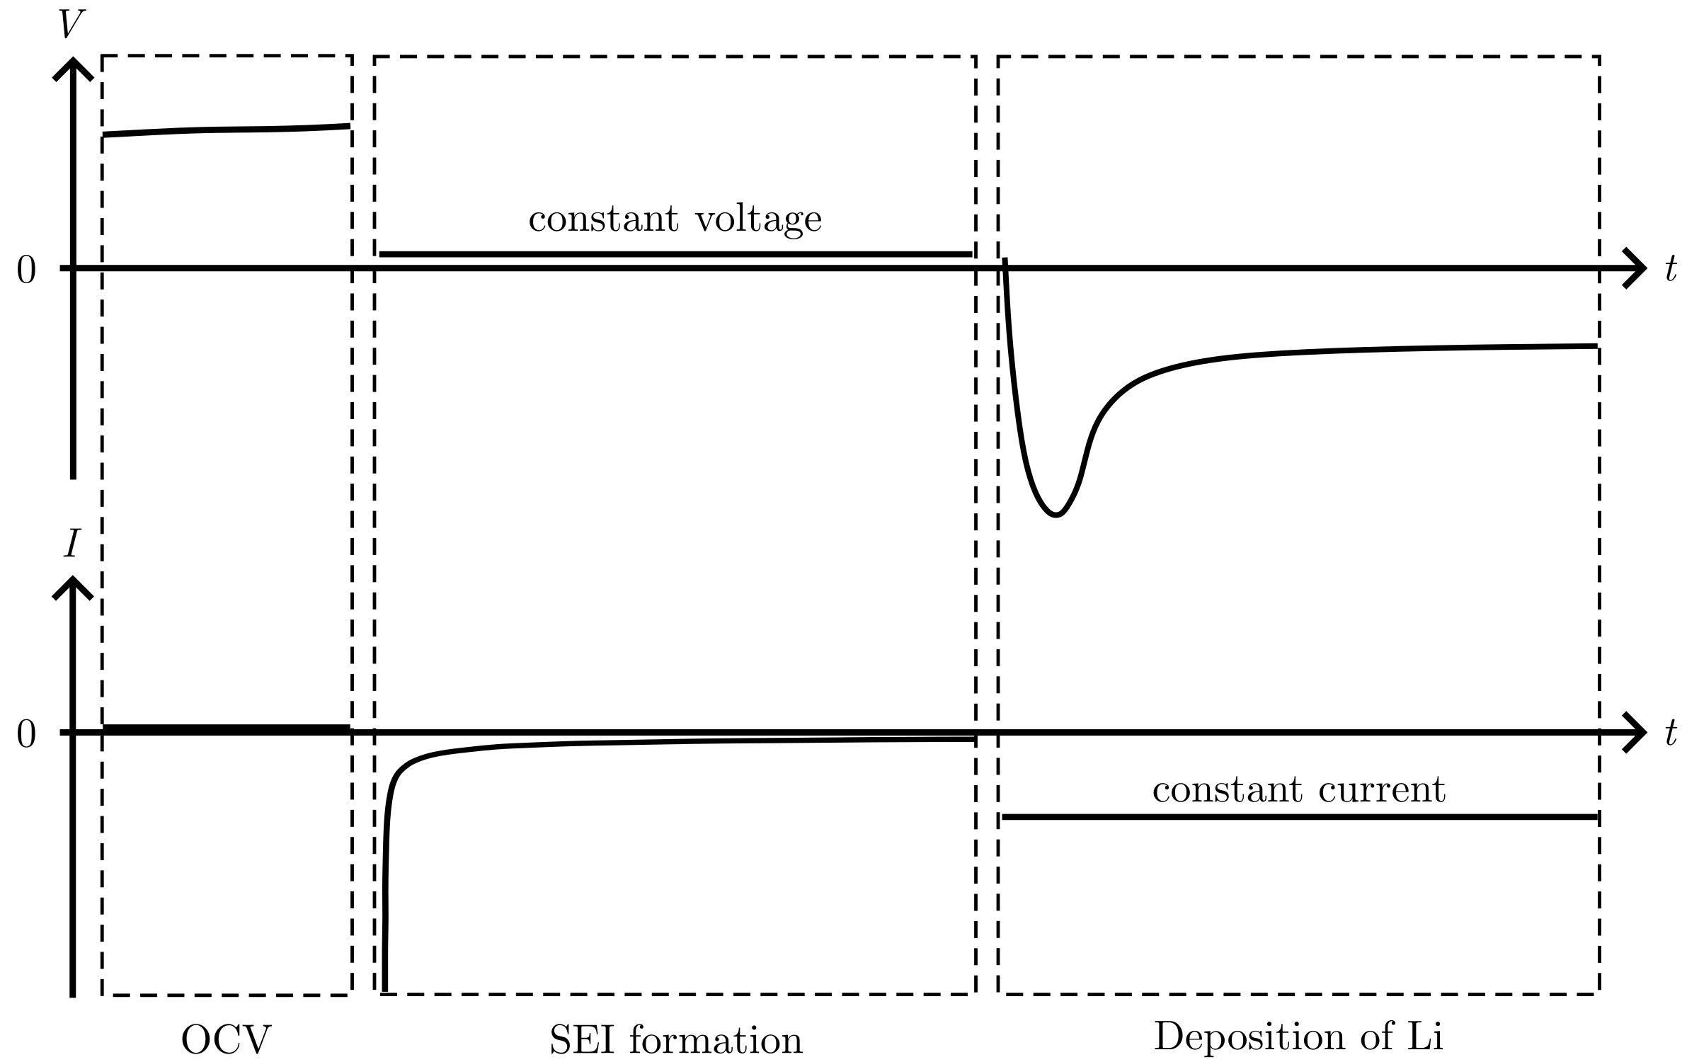
Deposition protocol
Notes:
The next step is the deposition.
A constant current is used, and the voltage is allowed to change freely.
This results in the deposition curve we saw earlier, with a sharp dip during the nucleation and then a flatter part during the growth.

Slide 61

Deposition protocol
Notes:
The protocol was set up to end the SEI formation once a low current I_SEIcutoff was reached.
For a low voltage hold, side reactions occur – one of them is SEI formation.
As the SEI layer grows in thickness, the side reactions decrease which we can see from the decrease in current.

Slide 62
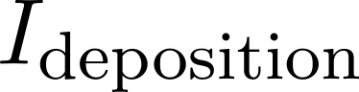
Deposition protocol
Notes:
And the deposition occurred at current I_deposition.
Now my specific research questions becomes more clear.
I have investigated how the deposition curve [point] is influenced by 2 things:
1) By varying the cutoff current during the SEI formation [point], …

Slide 63
Deposition protocol
Notes:
here…

Slide 64
Deposition protocol
Notes:
Here…

Slide 65
Deposition protocol
Notes:
Or here.
2) By different deposition currents [point]

Slide 66
Deposition protocol
Notes:
First, we look at how different I_SEIcutoff influences the deposition curve.

Slide 67
Passivation of the Cu surface
Notes:
To investigate the passivation of the Cu surface before deposition, several T-cell were cycled with different I_SEIcutoff

Slide 68
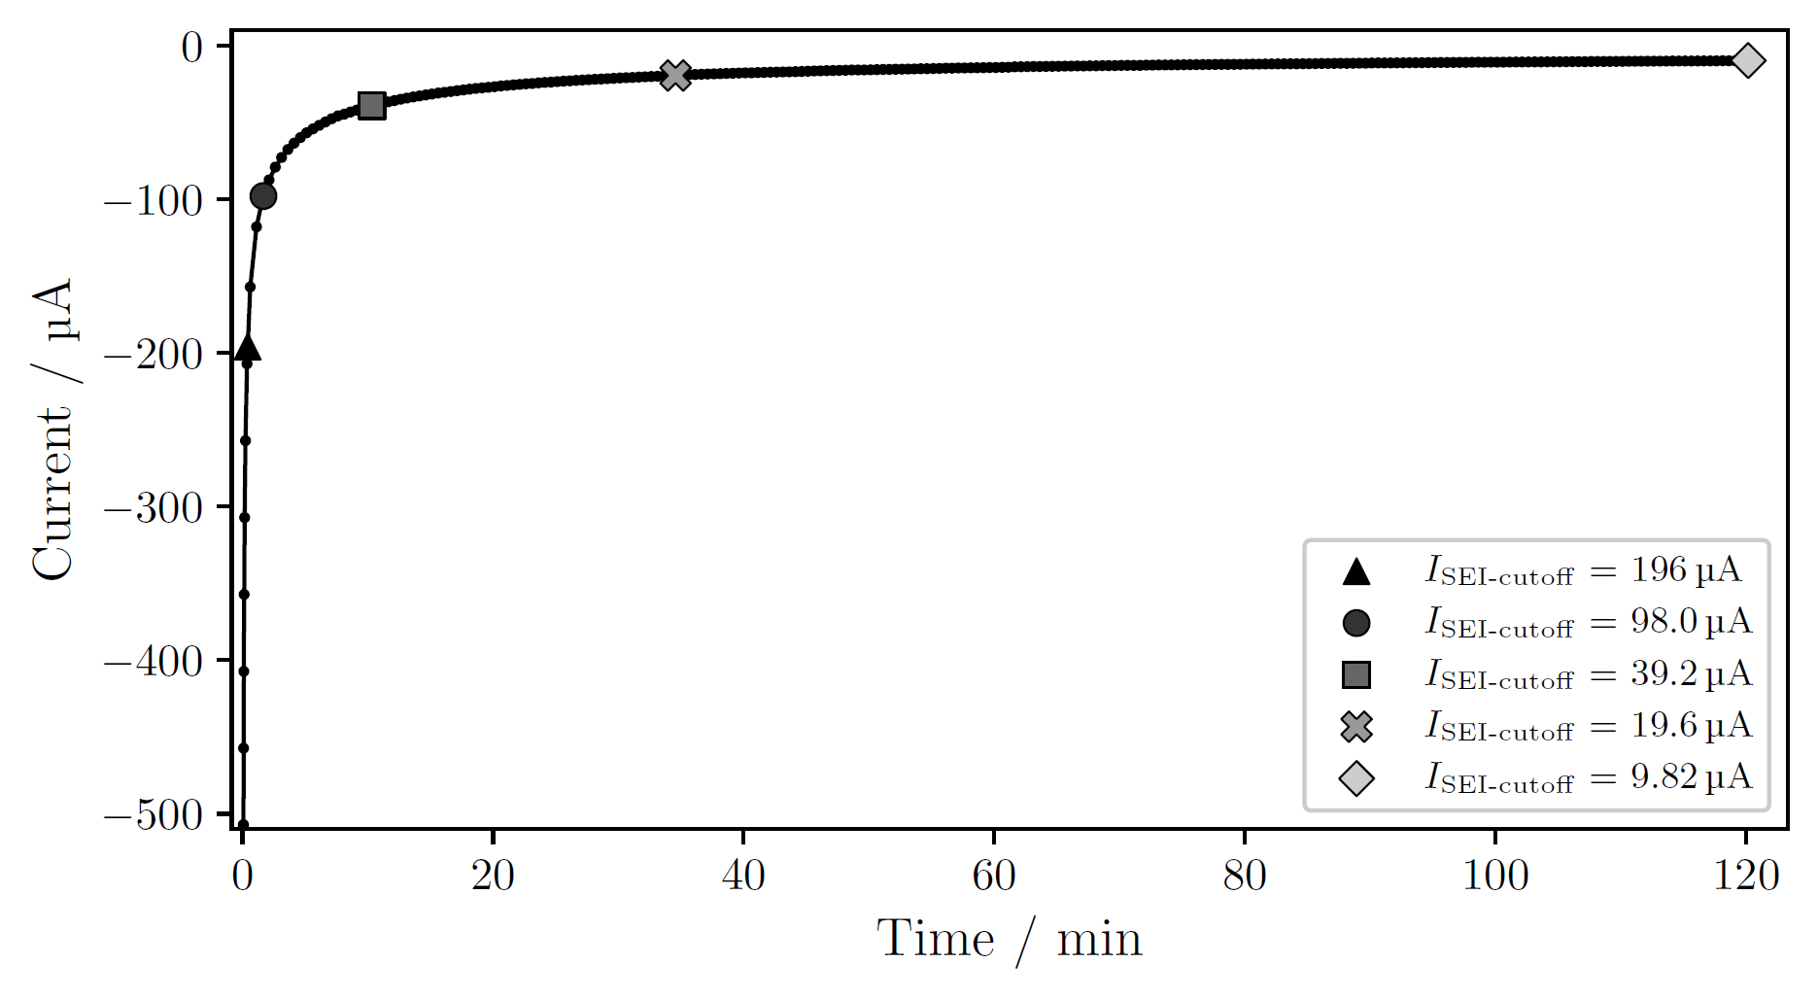
Passivation of the Cu surface
Notes:
First, the current versus time during the SEI formation by holding a constant low voltage.
T-cell, Jdeposition = 1 mAh/cm²
Here I have stopped the SEI formation for here for one cell, here for another.
Time increase for lower sigma: 2 min for 0.50, 2 hour for 0.05
After the passivation, Li was deposited at constant current

Slide 69
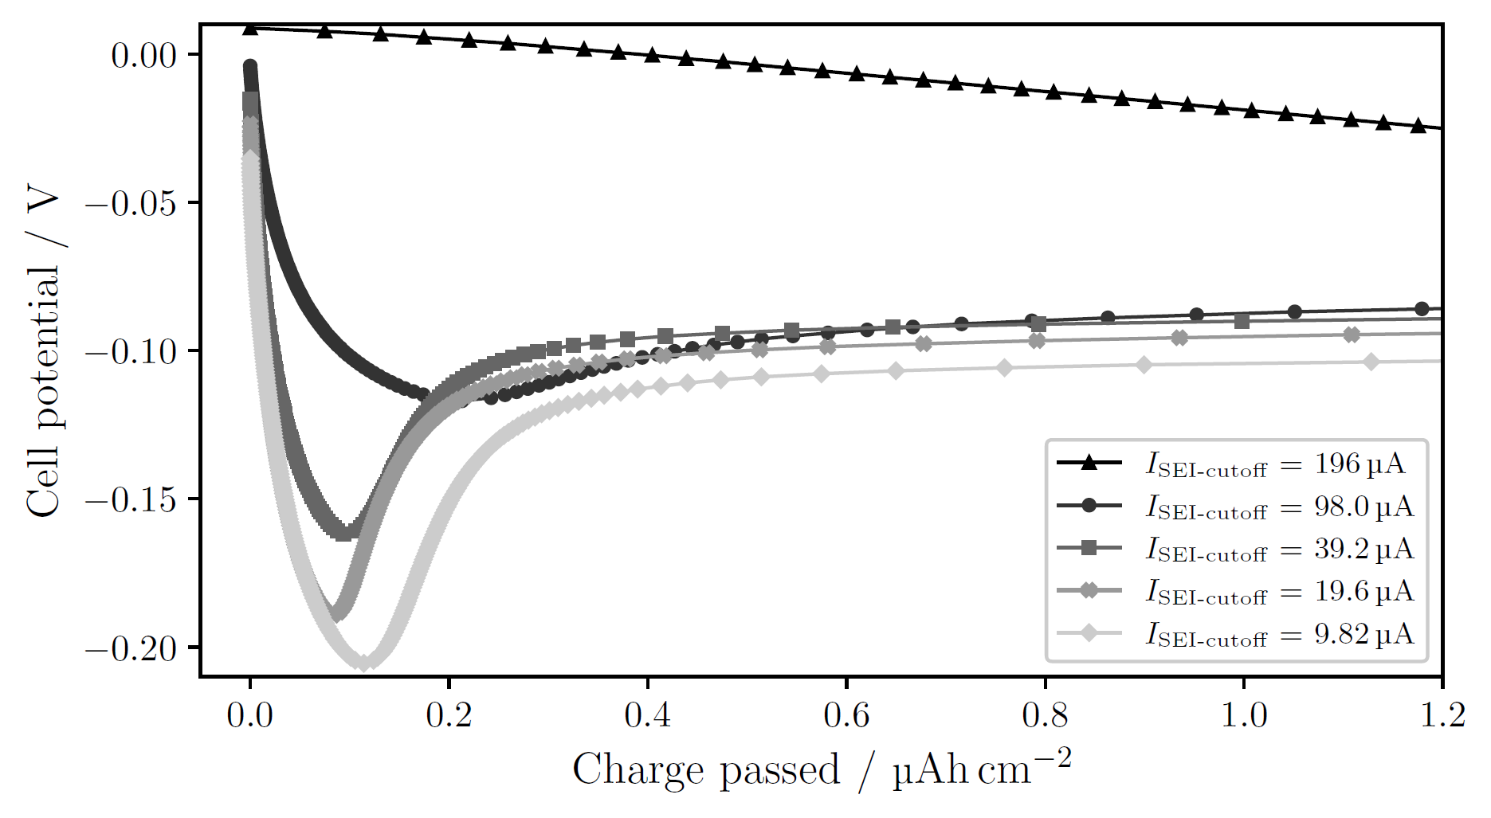
Passivation of the Cu surface
I_{deposition} = 196 µA
J_{deposition} = 1 mA/cm²
Notes:
T-cell, 1 mAh/cm²
sigma=1.00: no obvious nucleation; side reactions large enough to drive current without need for nucleation in the beginning
Decreasing sigma, meaning more passivation → clearer deposition peak at higher overpotential
More passivation → less side reactions during deposition → to get the that current it is necessary to nucleate a lot in the beginning, which only happens if the overpotential is large
Thus, more passivation leads to more instantaneous nucleation, where more or less all nuclei form at the start and then they only grow
Instantaneous nucleation is opposed to progressive, where new nuclei continue to form after the start

Slide 70
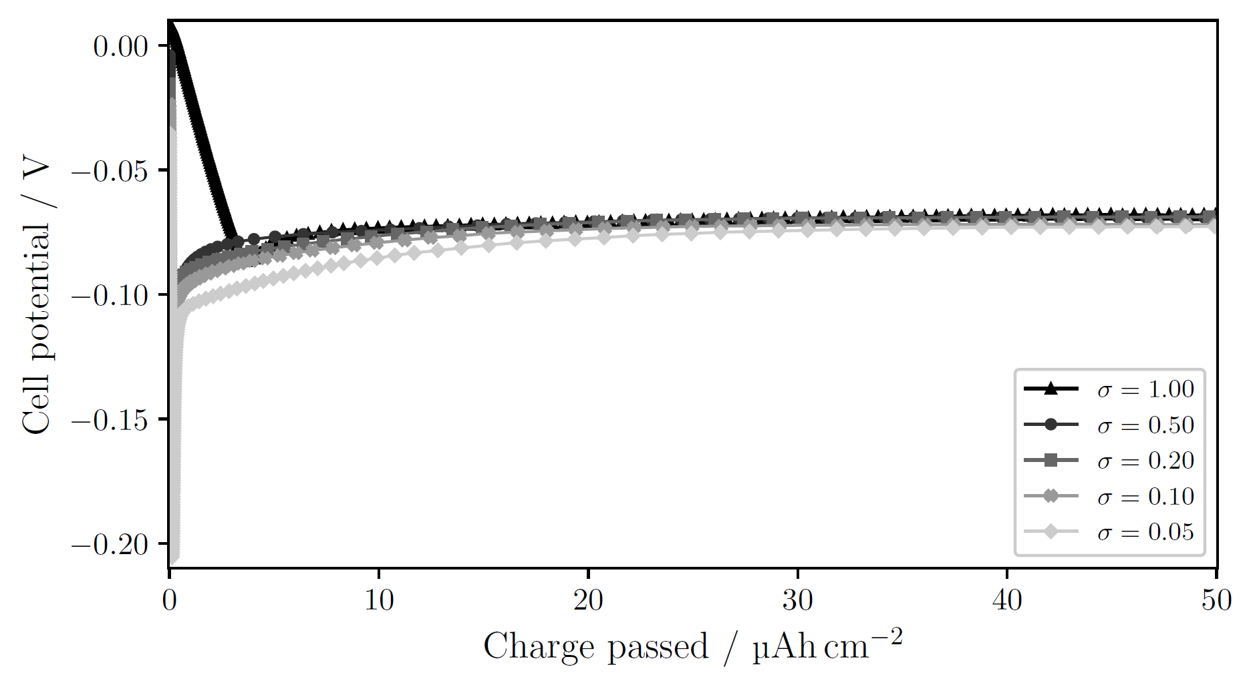
Passivation of the Cu surface larger charge passed
I_{deposition} = 196 µA
J_{deposition} = 1 mA/cm²
Notes:
(hidden) T-cell, 1 mAh/cm²

Slide 71
Deposition protocol
Notes:
Now, we look at how different currents during deposition influences the deposition curve.

Slide 72
Deposition current
Notes:
Several C-cells were cycled to see the effects of the deposition current on the deposition curve.

Slide 73
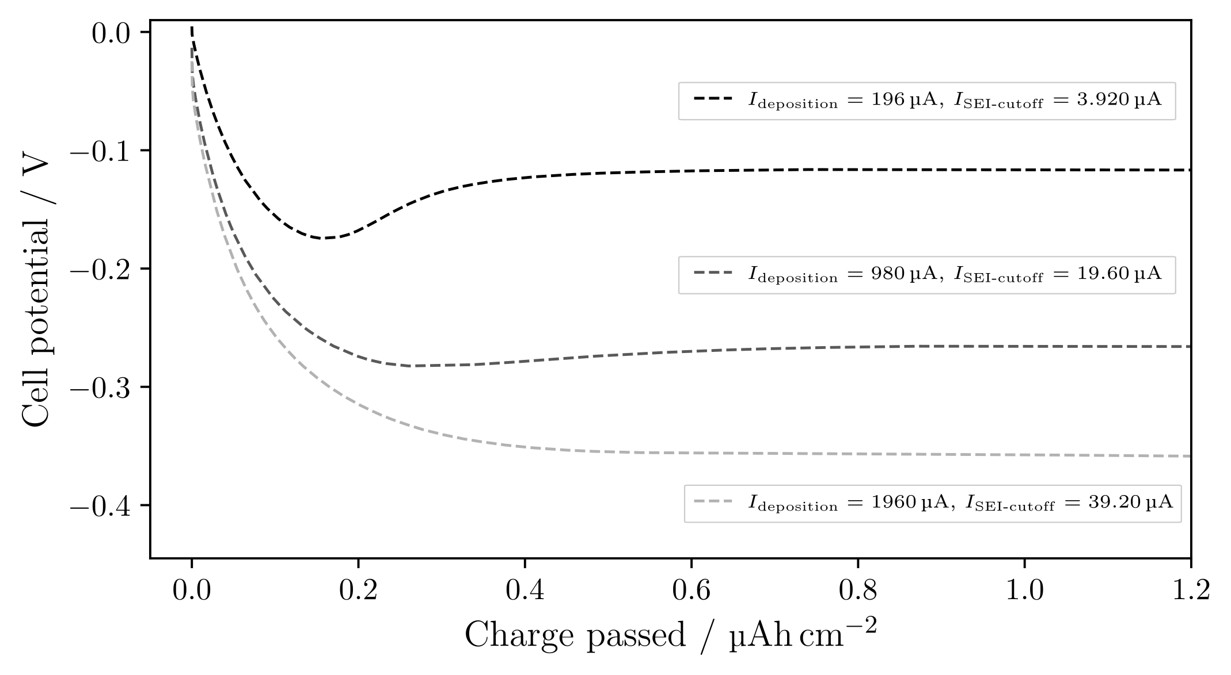
Deposition current
Notes:
Increasing current, J, results in a higher overpotential.
And higher overpotential should according to theory…
{J=1, 5, 10 mA/cm2}

Slide 74
Deposition current
Notes:
Result in smaller but more nuclei.
With the same sigma, the nucleation peak disappears for larger currents.
We just saw that the deposition peak is dependent on sigma, so what would happen if we passivated the surface more?

Slide 75
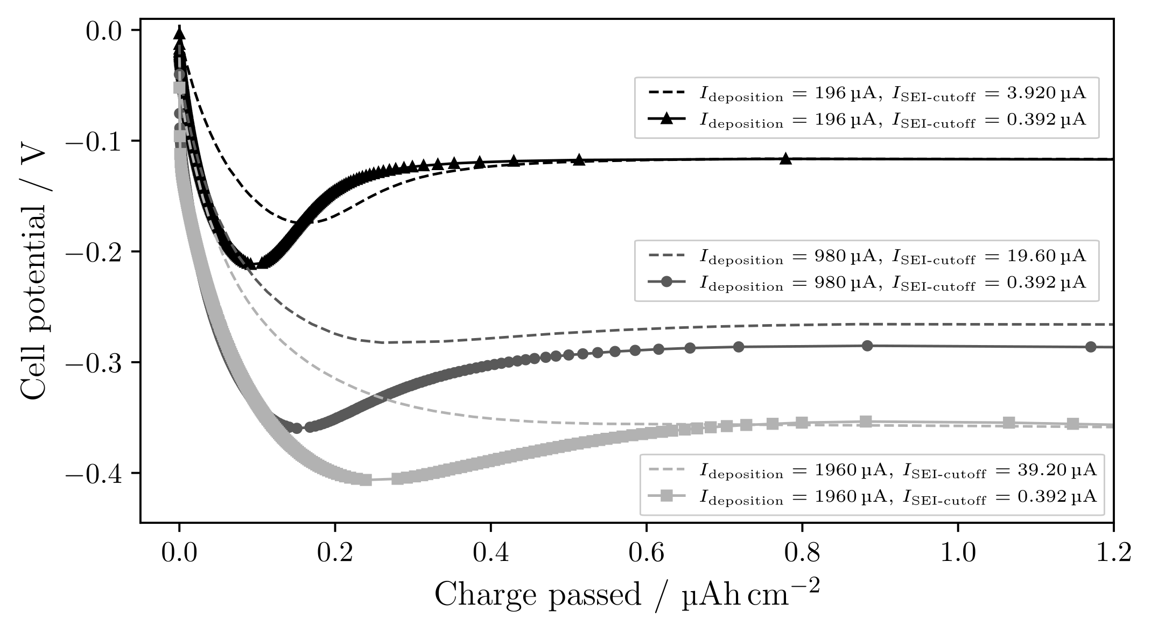
Deposition current with more passivation
Notes:
Now the deposition peak becomes visible for larger currents.
As discussed, the more pronounced deposition peak indicates more instantaneous nucleation.
Thus, current used should influence r and N, and the degree of passivation influences the nucleation process.

Slide 76

Deposition current with more passivation larger charge passed
Notes:
The cells reach more or less the same potential at larger charge passed, indicating either that:
1. The surface gets passivated during the beginning of the deposition.
2. Or, that the growth is not as sensitive to the side reactions as the nucleation is.

Slide 77
Pressure effects
Notes:
To investigate the effect of pressure, a C-cell was first cycled

Slide 78

Pressure effects
Notes:
Photograph Li on Cu:
we see uneven deposition from the annulus: little to no Li in the middle, but more for larger radii
Photograph: 500 muAh/cm2
SEM-images: 25 muAh/cm2 at 1mA/cm2

Slide 79

Pressure effects
25 µAh/cm²
Notes:
Scanning electron microscope (SEM)-images, overlain: I’ve matched the features on the images with each other to give a view of a larger area

Slide 80

Pressure effects
25 µAh/cm²
Notes:
If we zoom in we see small Li nuclei.

Slide 81

Pressure effects
25 µAh/cm²
Notes:
Moving down, see slightly larger nuclei.

Slide 82

Pressure effects
25 µAh/cm²
Notes:
Here even larger nuclei.
Thus, for various radial positions we see different morphologies of Li: from small crystalline particles to larger ‘’islands’’

Slide 83
Pressure effects
2r = 1 µm
2r = 2 µm to 3 µm
2r ≥ 4 µm
25 µAh/cm²
Notes:
The typical size (diameter) of the nuclei goes from 1 micro meter here, 2 to 3, and then larger than 4.

Slide 84
Pressure effects
2r = 1 µm
N = 0.024 nuclei/µm²
2r = 2 µm to 3 µm
N = 0.022 nuclei/µm²
2r ≥ 4 µm
N = 0.016 nuclei/µm²
25 µAh/cm²
Notes:
Nuclei per area decreases while the nuclei size increases

Slide 85
Pressure effects
2r = 1 µm
N = 0.024 nuclei/µm²
2r = 2 µm to 3 µm
N = 0.022 nuclei/µm²
2r ≥ 4 µm
N = 0.016 nuclei/µm²
25 µAh/cm²
Notes:
These relations should be familiar by now.

Slide 86

Pressure effects
Notes:
So, the distribution changes radially. How about the along the edge of the deposition?

Slide 87

Pressure effects
50 µAh/cm²
Notes:
SEM images for different angles around the edge of the deposition.
Photograph: 500 muAh/cm2
SEM-images: 50 muAh/cm2 at 1mA/cm2

Slide 88

Pressure effects
50 µAh/cm²
Notes:
Zoom in: see some particles, and bush-like growth

Slide 89

Pressure effects
50 µAh/cm²
Notes:
Here it’s mostly round particles

Slide 90

Pressure effects
Notes:
Down here: overwhelmingly bush-like growth.
Yes, the deposition changes also with the angle along the deposited annulus.
Is this a pressure effect?

Slide 91


Pressure effects
Wave spring
Notes:
The reason is probably the wave spring used in the C-cell.
A study found that the wave spring induces uneven pressure in the cell, with low pressure in the middle and higher pressure for larger radii.
Exactly as the annulus of deposited Li shows.
Photograph shows that the wave spring pushes down at some points,
which could explain the angular variation with more bush-like growth at some places than others.

Slide 92
Pressure effects
Notes:
We have seen that uneven pressure leads to uneven deposition.
To verify that even pressure makes more even deposition, a T-cell was cycled and measured in SEM.

Slide 93

Pressure effects
300 µAh/cm²
Notes:
SEM images as before, over the same distance as in the C-cell, the Li distribution seems more or less the same.

Slide 94

Pressure effects
300 µAh/cm²
Notes:
Zoom-in shows that the morphology is small crystalline particles, with longer and thinner needle-like growth.
While ‘’islands’’ were not observed in the T-cell, we could image that this needle-like growth might evolve into the bush-like growth we saw in the C-cell.

Slide 95

Conclusions
1) More instantaneous nucleation can be induced by passivating the surface more before deposition.
Notes:
What have we learned?

Slide 96

Conclusions
2) To drive a larger current, a larger overpotential is necessary. This should result in smaller nuclei with larger areal density.

Slide 97
Conclusions
3) Uniform pressure between the electrodes is essential to achieve uniform deposition in Li-metal batteries.

Slide 98
Thank you for listening!

Slide 99
//Lägg in fler plots här efter på större charge och andra figurer som Isak kanske kommenterar

Slide 100
Electrochemical deposition of lithium on copper
Gottfrid Olsson
2024‒05‒29

